Slide 1


Making Friends with Facilities and Crushing Capital Projects
NW/MET
April 30, 2025
Boise State University

Slide 2
Agenda – The Panel
Panelist Introduction
Brief History – Where Did the Relationship Start?
What Did you Work on to Improve the Process?
Where are you Now?
What's Next?
Q&A

Slide 3



Do not edit
How to change the design
What word would you use to describe your relationship with your facilities team?
The Slido app must be installed on every computer you’re presenting from

Slide 4
Making Friends with Facilities and Crushing Capital Projects
NW/MET
April 30, 2025
Boise State University
Notes:
I think we need this as the walk-in slide as well so people know they've found what they are looking for

Slide 5
Agenda – Presentation
About Us & Shameless Plugs
A Cautionary Tale
How to Make Friends
Gifts for Friends!
Keys to Successful Capital Projects
A Success Story
Q&A

Slide 6
About the Presenter
Mike Pedersen, CTS-D, CTS-I
Audiovisual Experience Manager
Audiovisual Experience Team (AVXT)
Information Technology Services (ITS)
Iowa State University
#InHouseIntegrator
6th Year at Iowa State University
19 Years at Audiovisual Integrator called Mechdyne Corporation

Slide 7
Higher Education Technology Managers Alliance (HETMA)
  1 Year At-Large Board Member
Higher Ed AV Media
  Columnist Integrator Insights
  Team Won AV Team of the Year in 2023
ETC
  Membership Co-Chair
  Program Committee
  Board Member Elect
AVIXA
  2018 CTS Holder of the Year
  Membership Committee
  CTS Renewal Committee

Slide 8
Iowa State University
Public Land-grant University
Founded 1858
Fall 2023 Enrollment: 30,177
10 Schools and Colleges
100 Majors
World’s first electronic, digital computer invented here, 1942
Ames, Iowa
  #1 on 2019 US News Best College Towns
    https://www.usatoday.com/story/money/2019/09/07/best-college-towns-these-30-rank-among-30-top-us/2235088001/
  #1 Midwest on 2023 Research.com Best College Towns List
    https://research.com/universities-colleges/best-college-towns-and-cities-in-america

Slide 9
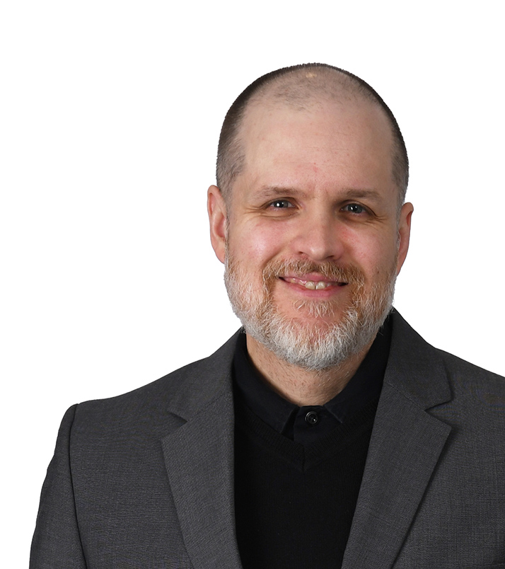
About the Presenter
Josh Hamon, CTS-D, ANP, CCNA
US West AV Team Leader
Stantec
#Consultant
3rd Year at NWMET

Slide 10
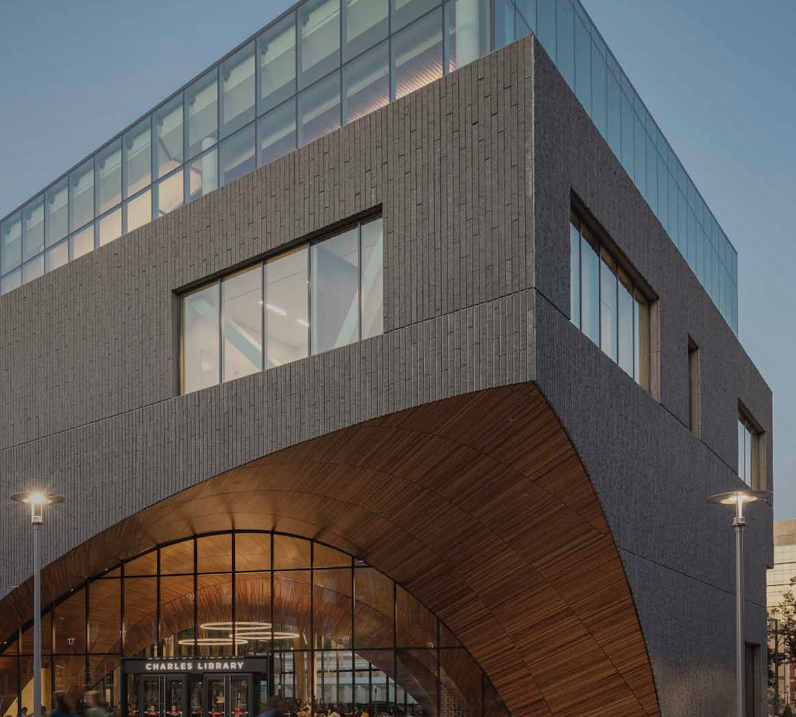
Stantec
Global leader in sustainable engineering, architecture, and environmental consulting
Largest AE in North America
13,500 Headcount (Buildings)
#1 University Building Design
  By BD+C, 2023

Slide 11
Shameless Plugs

Slide 12


ETC
Educational Technology Collaborative (Formerly CCUMC)
Professional and leadership development
Outstanding collaboration
https://www.etcollaborative.org/

Slide 13




Imagine the Possibilities,
Achieve the Extraordinary!
2025 ANNUAL CONFERENCE
October 14-17, 2025
Raleigh, NC

Slide 14

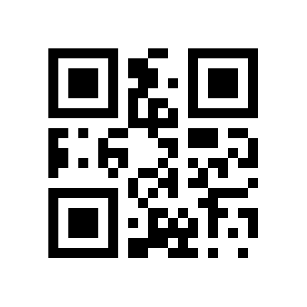
HETMA
Higher Education Technology Managers Alliance
Advocacy for Higher Ed within the Professional AV market
PRISM Scholarship
HETMA Approved Program
https://hetma.org

Slide 15
A Cautionary Tale

Slide 16
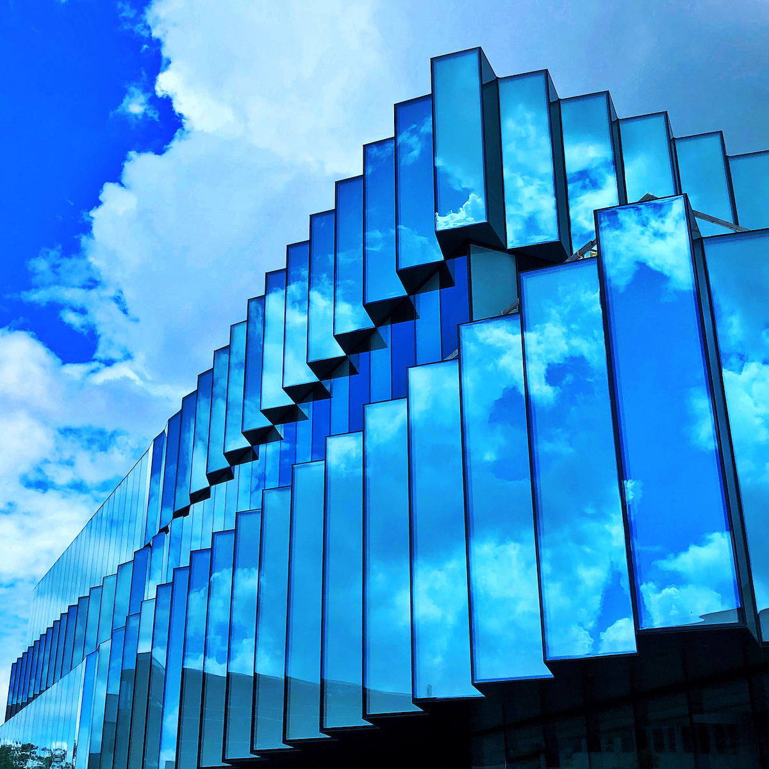
ISU Student Innovation Center
New Building Opened in 2020; 140,000 SF
Detailed design work occurred in 2016-2017
  ISU lays off all senior AV staff in May 2016 to outsource…
An audiovisual contractor was not selected at the same time as the GC

Slide 17
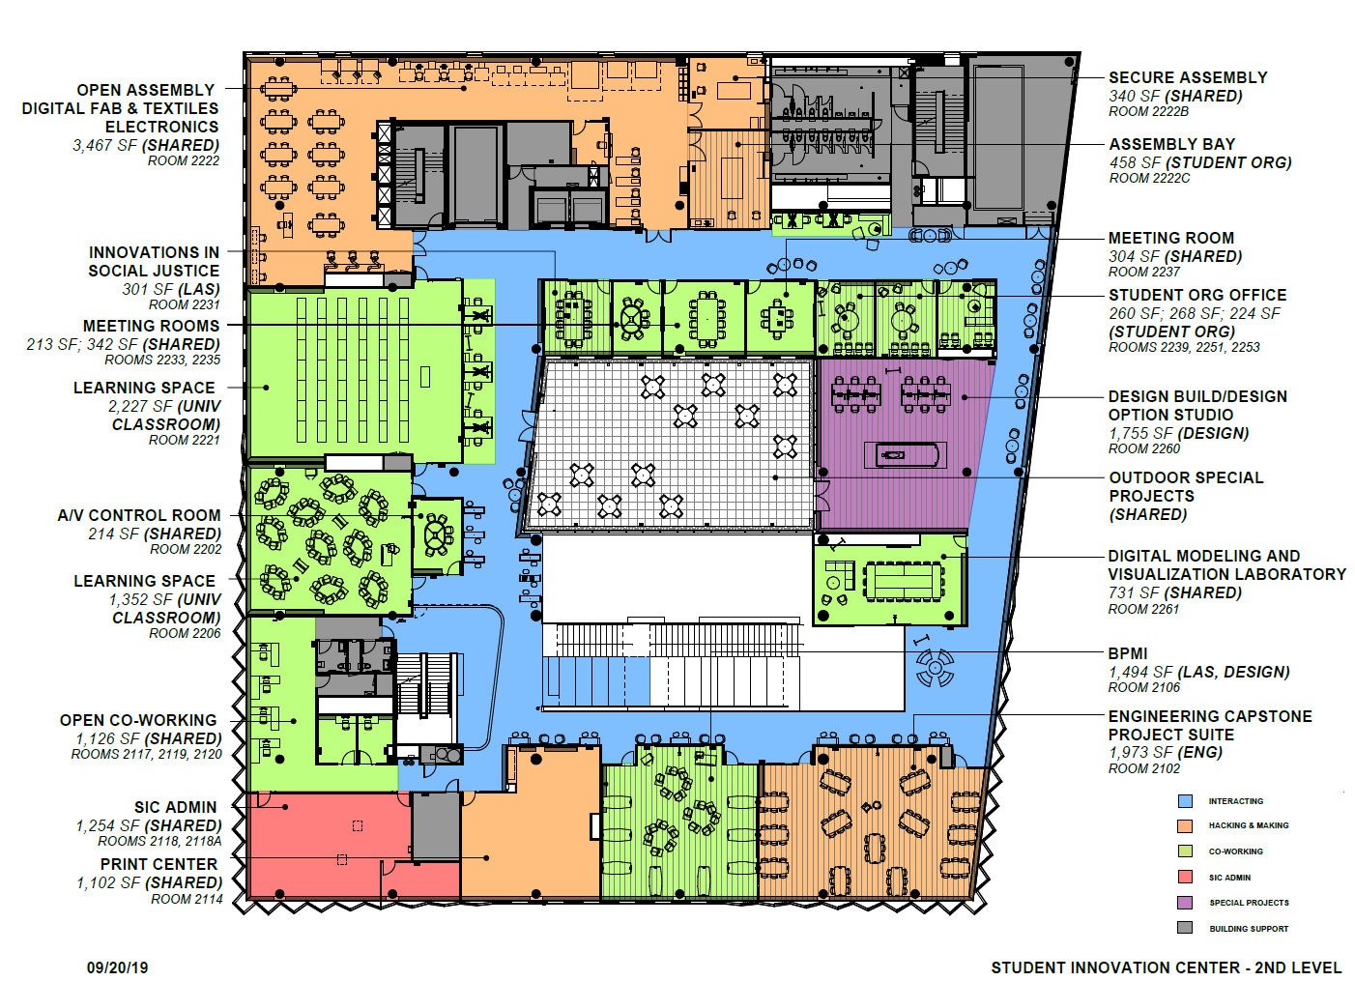
Went Bad from the Start
No Space Ownership
  Designed by committee
  AV needs analysis in a vacuum
No audiovisual experts from ISU involved
AEC consultants planned for very basic audiovisual systems
Infrastructure not considered for current and future new technologies
Lack of vision → underfunding of AV in the initial plans

Slide 18
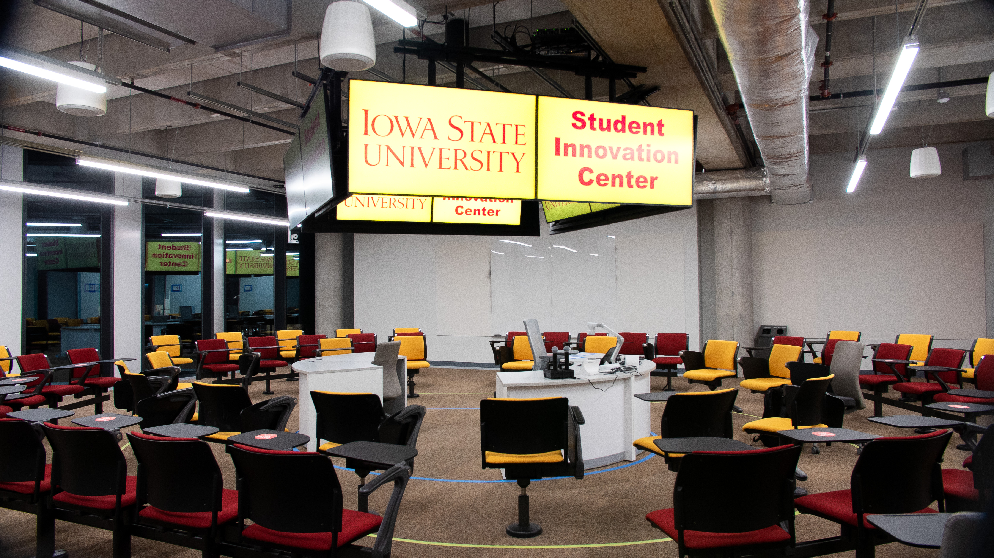
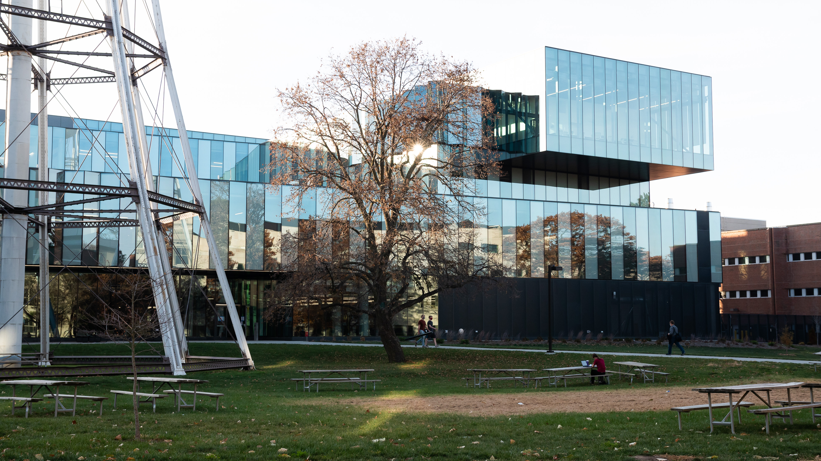
What NOT to Do
Final room owners still being decided two full years after breaking ground
Room owners then (rightfully) asked for changes to how rooms functioned
Those changes then needed multiple levels of approval → Delays!
We estimate it cost the University in excess of $200,000 in infrastructure change orders

Slide 19
How to Make Friends

Slide 20

Trust and Respect
Trust and respect are earned, not given by default
Keys to building professional relationships
  Show up
  Do what you say you’re going to do
  Keep their interests in mind

Slide 21
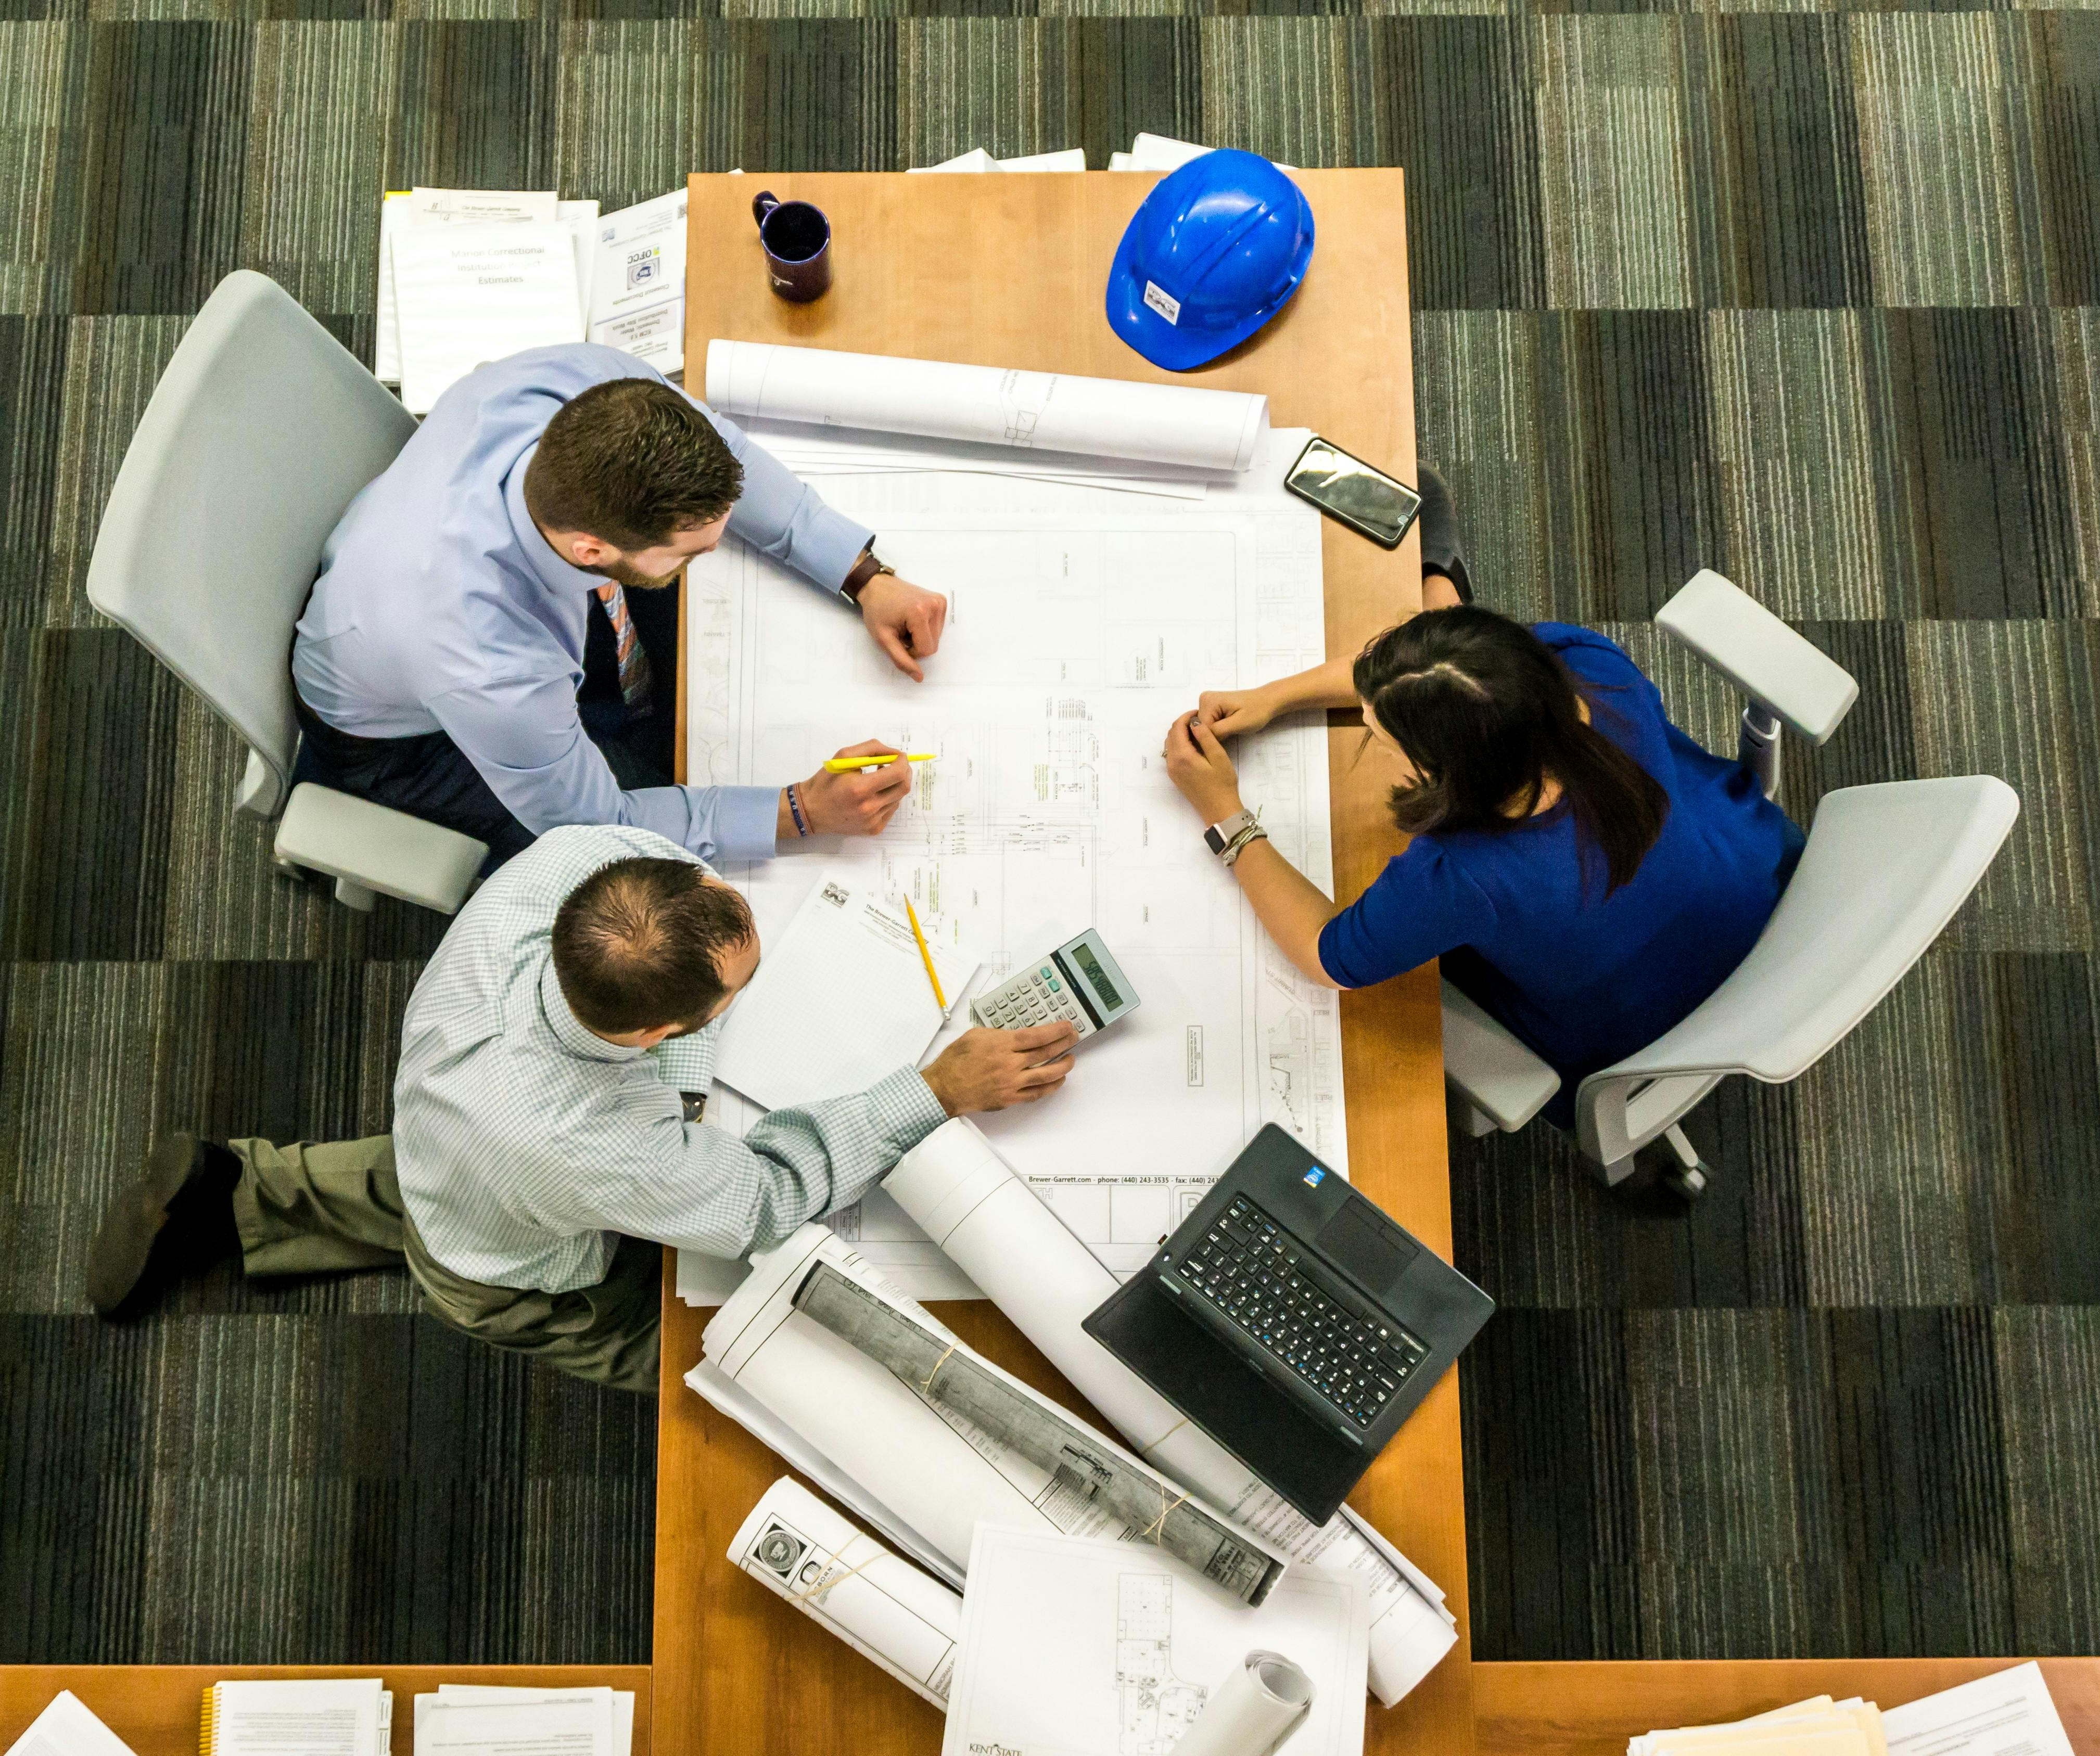
Know the Players
In higher education capital construction projects (and other places) it is important to recognize the players involved
  End users
  Campus facilities (in UK, estates) team
  Campus IT and AV team
  AEC designers and consultants
    AEC = Architecture, Engineering, and Construction
  AV designers and consultants
  General contractor (GC)
  AV integrator

Slide 22

Seats
My Engineering Management professor says “the right answer often depends on what seat you are in”

Slide 23


End users
It is vital to understand the end user needs
Do not design rooms in a vacuum
Consider more than tech – how does the room need to flow or function with doors, windows, furniture
Identifying (and getting access to) end users can be very hard!

Slide 24

Needs Analysis
Doing a proper needs analysis could be a class of its own!
Ask good open-ended questions on functionality and experience
  “From the time a person enters this room until they leave, what should they experience?”
  “Looking back a year from now, how would you determine if the space was successful or not?”
If they start talking tech specifics – stop them – refocus to workflow and functionality

Slide 25
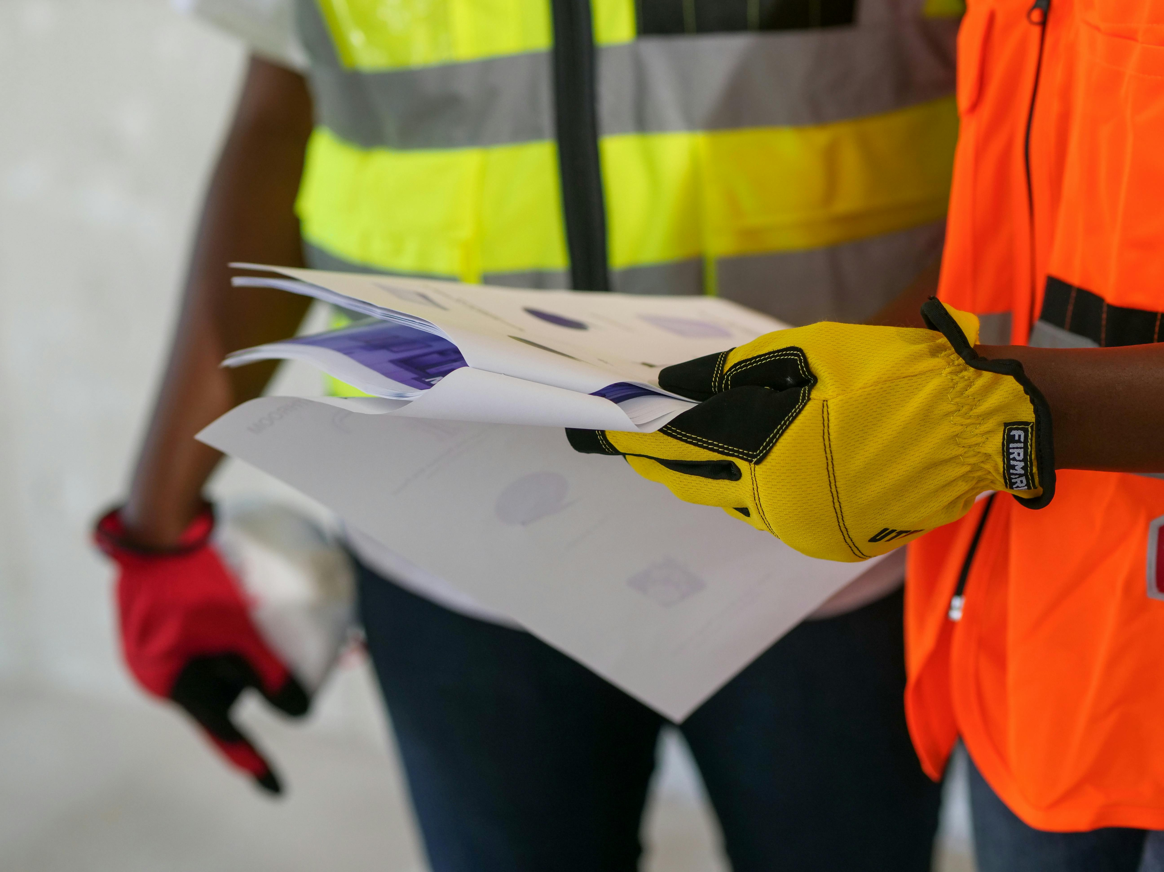
Campus Facility Teams
Build a relationship with your facilities team
Focus on project managers (PM) and construction managers (CM) - offer to help
Provide them standards - drawings are worth a thousand words

Slide 26
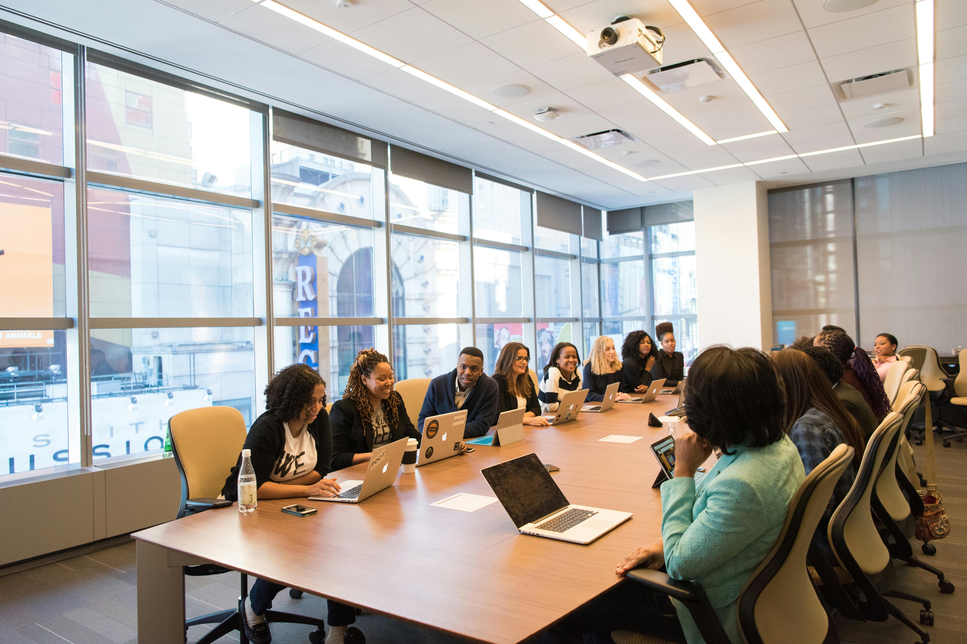
Recurring Monthly Meetings
Setup a recurring monthly meeting with the facilities PMs and CMs
Review current and upcoming capital projects
Ask if there are any AV needs in the upcoming projects
Ask to be invited to project review meetings

Slide 27

Understand their lingo
Construction documentation project stages
  Programming
  Schematic Design (SD)
  Design Development (DD)
  Construction Documentation (CD)
  Bid Documents
  Construction Administration (CA)
Coordination
Change Orders

Slide 28
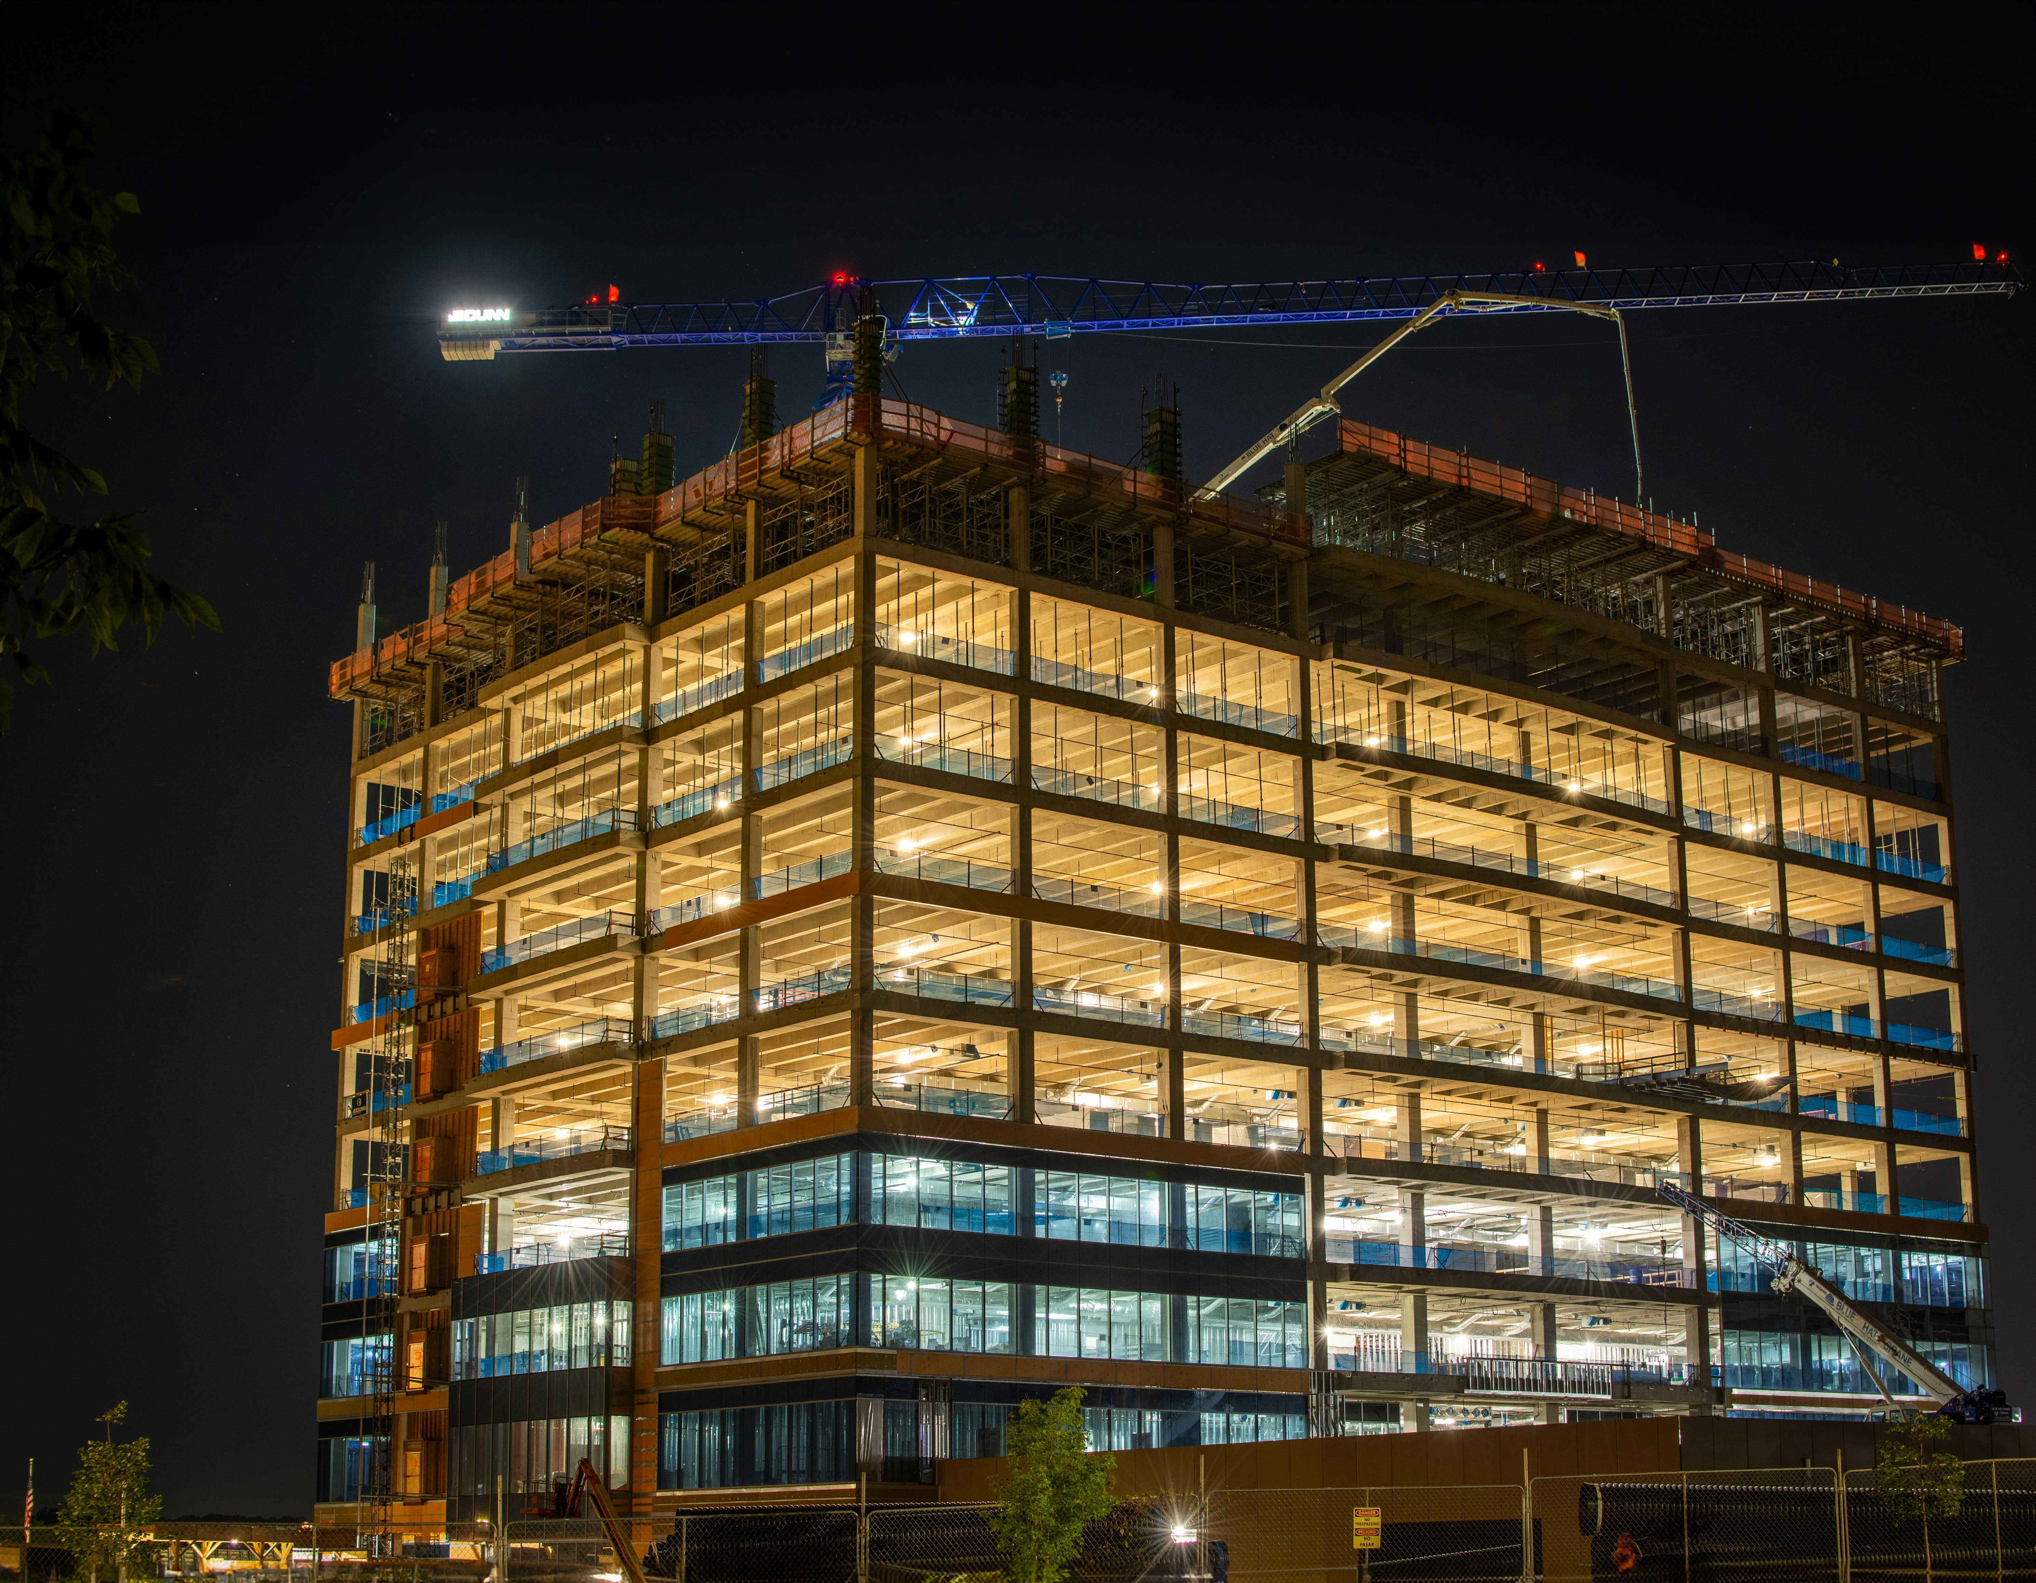
Understand the Process
Different delivery methods
Different based on project size or department
Design-Bid-Build
Design-Build
Progressive-Design-Build
CM @ Risk
Is the AV included in the GC bid or separately?

Slide 29
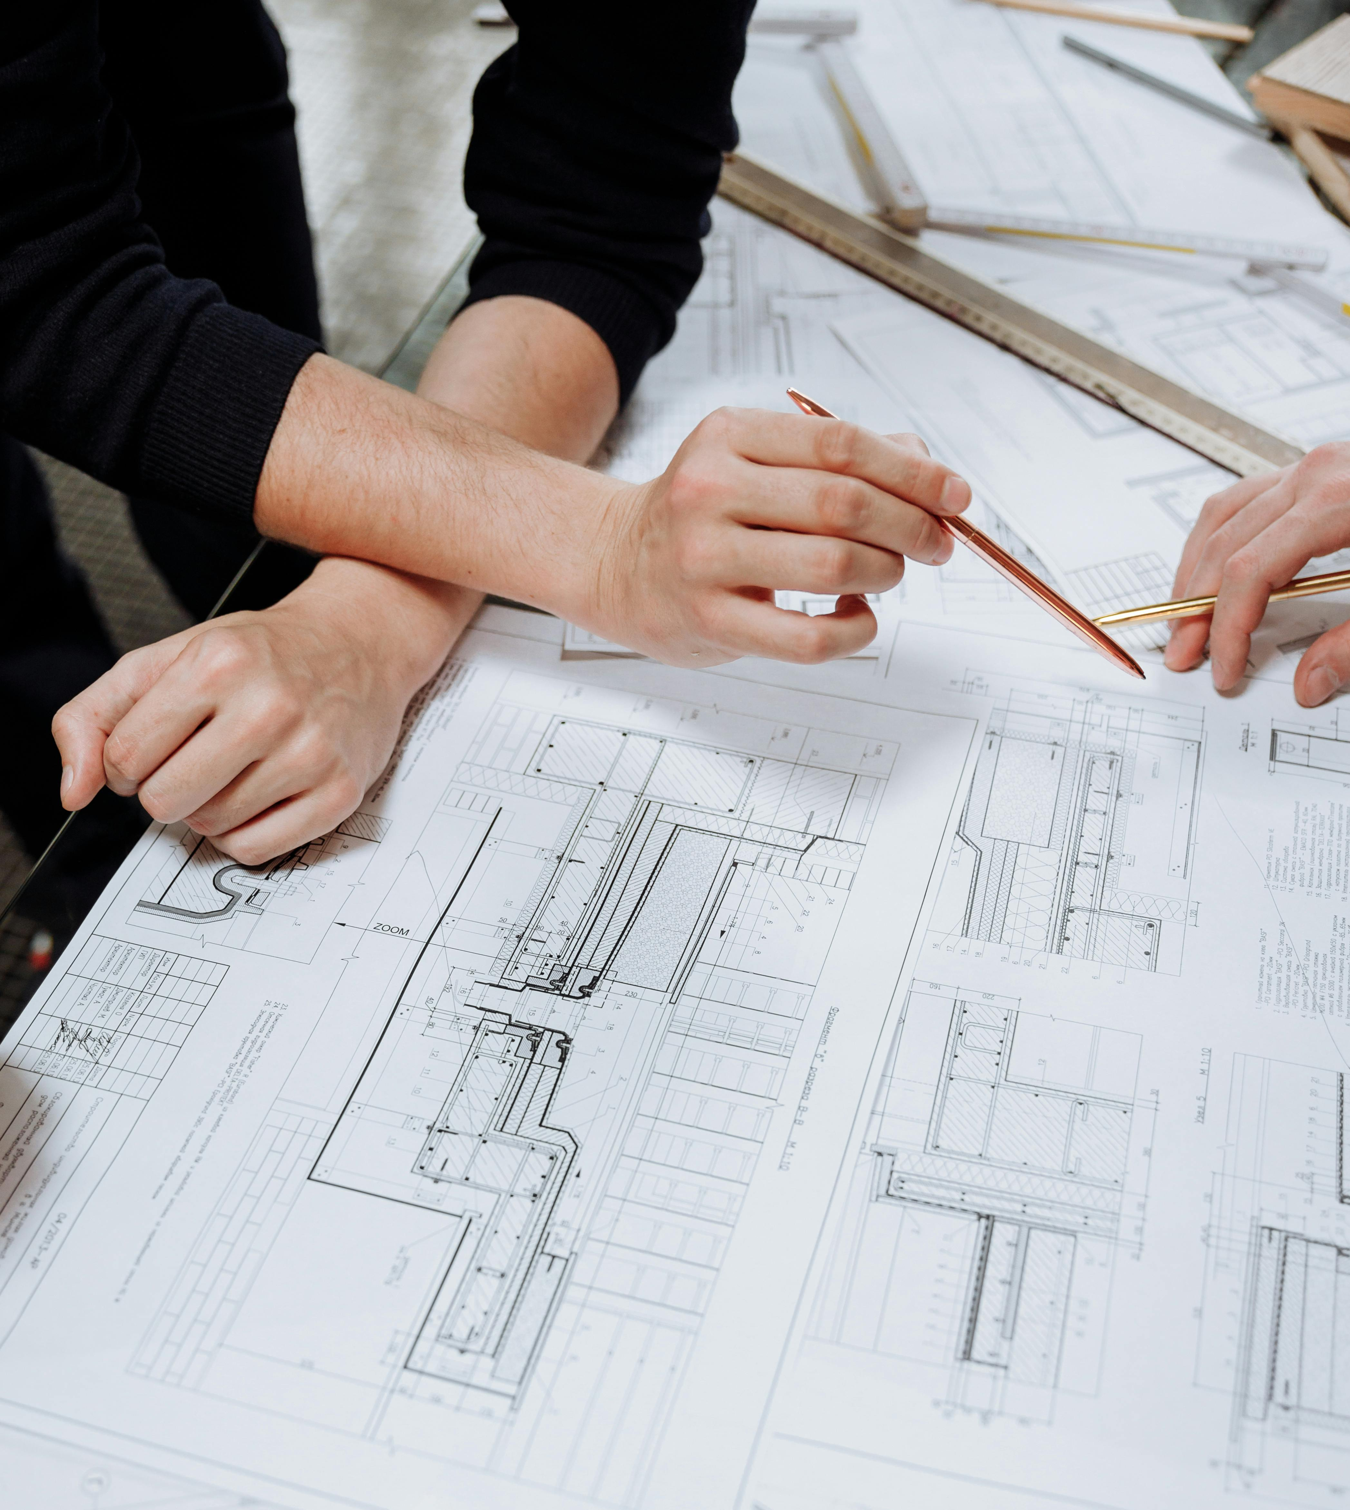
AEC Consultants
They work for the architect
Engage early (hint – befriending facilities PMs can help!)
Show them written standards and drawing details
MasterFormat – 27 41 00
Reduce their workload
Acoustics can be invaluable

Slide 30

AV Consultants
Introduce yourself
Stake some authority (if possible)
Make connections for them
  Facilities, IT
  End users and stakeholders
  Don’t be a blocker
Written campus documentation
  Shows it is not just “your opinion”

Slide 31
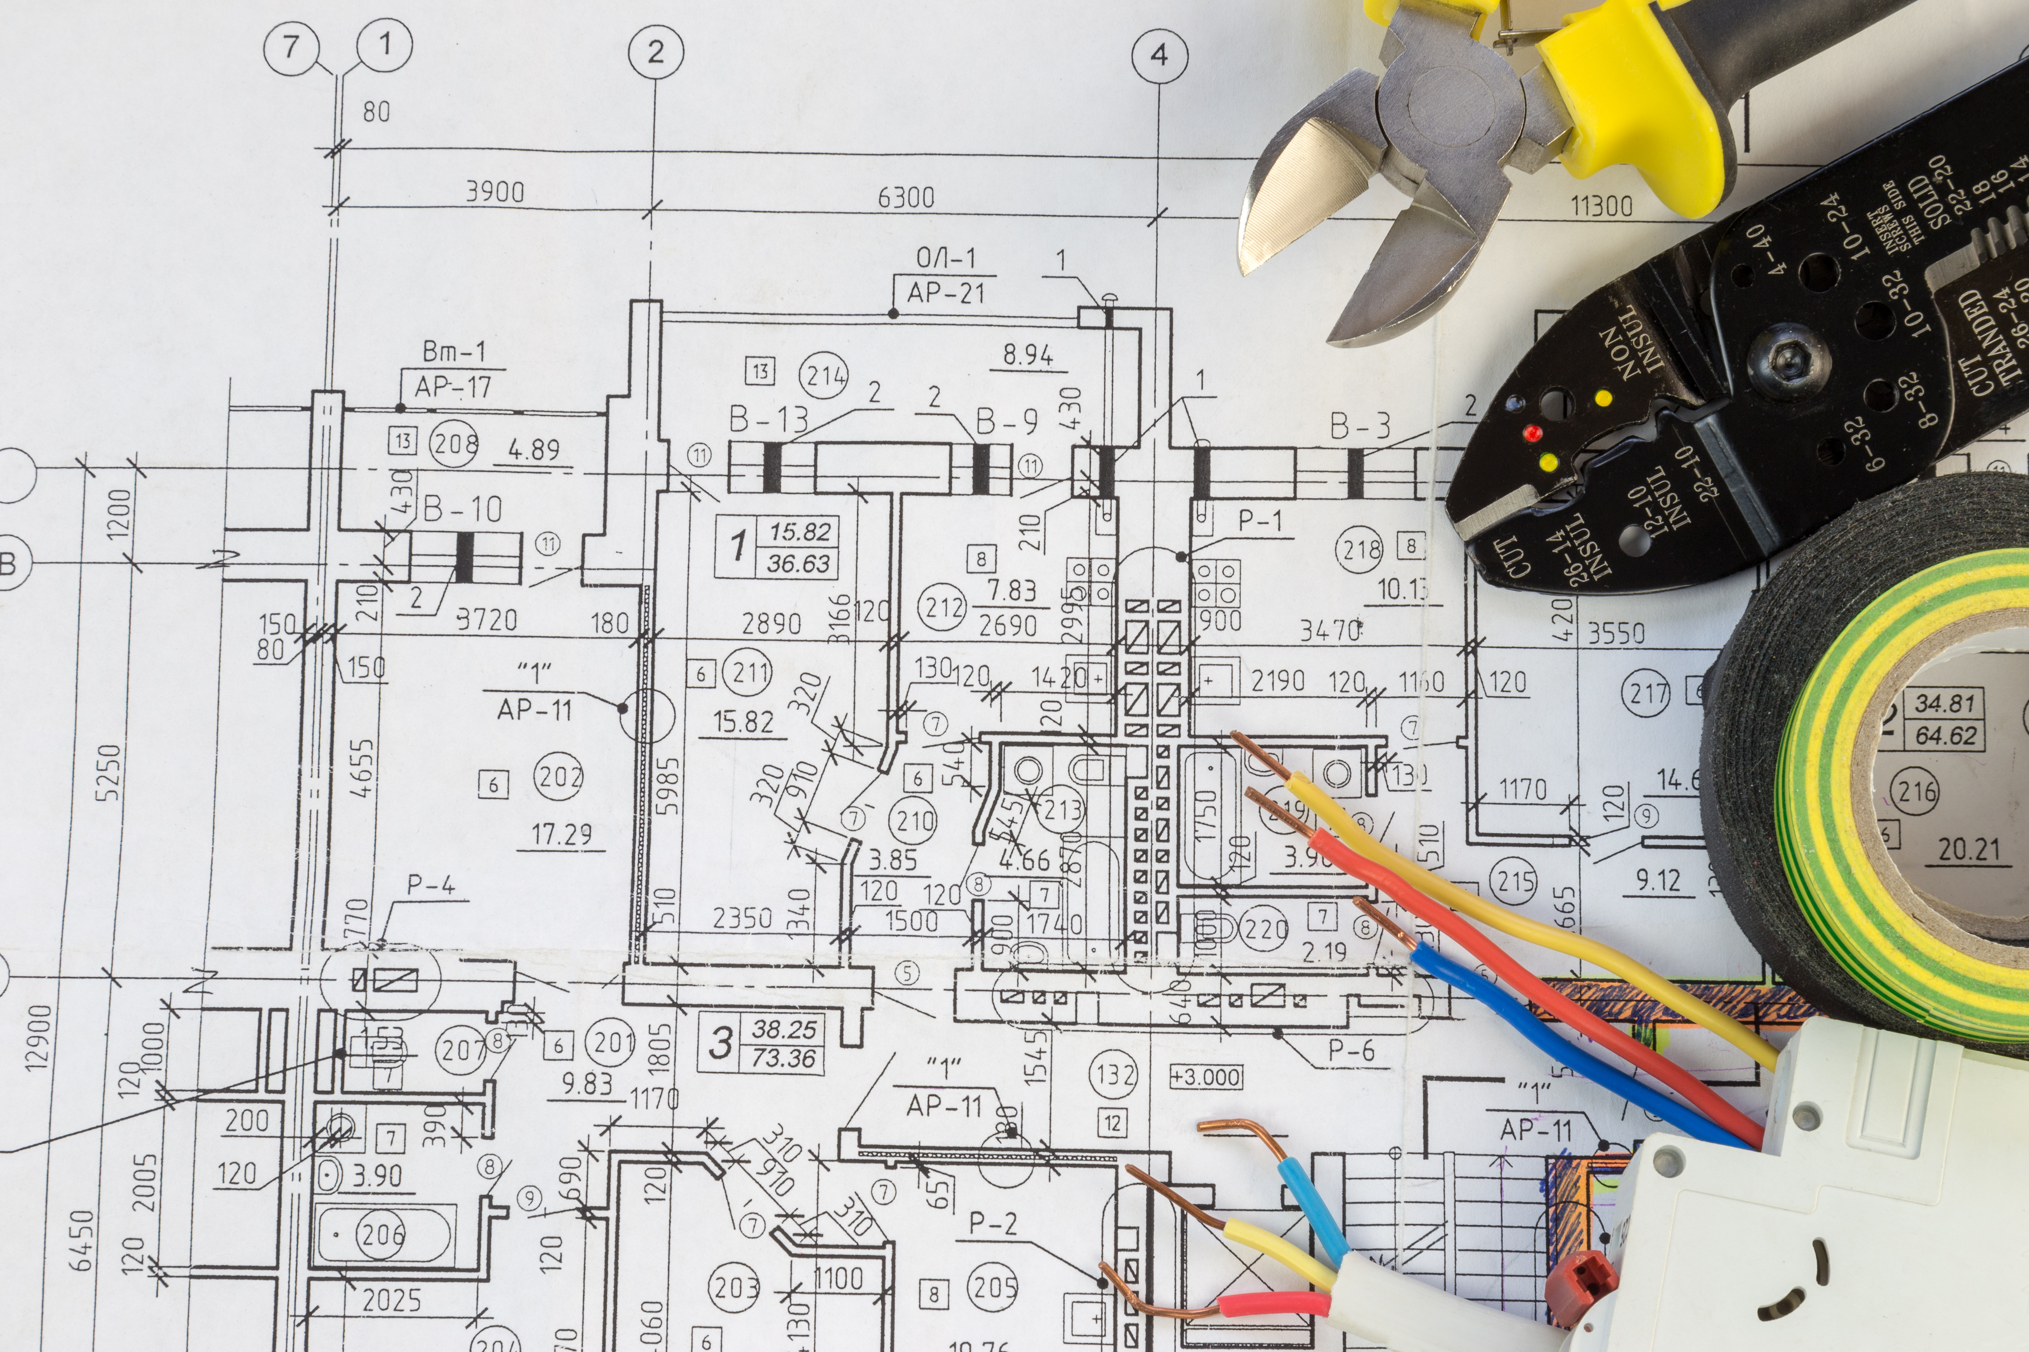
General Contractors
Respect the “chain of command”
  When interacting with the GC, ensure the university PM is aware
  Sometimes may be better to engage through the university PM
Ask to be involved in project meetings
Advocate for time
You’re on their side

Slide 32
You will need an outside AV integrator
Three types of institutions
Not yet ready to take on in-house integration
You will need a regular ongoing integration partner
Partial and developing in-house integration
While you tackle the easier projects, you need an integrator for everything else
Established in-house integrator
You will likely face projects too large to attempt in-house
You are likely not staffed enough for the big summer push

Slide 33
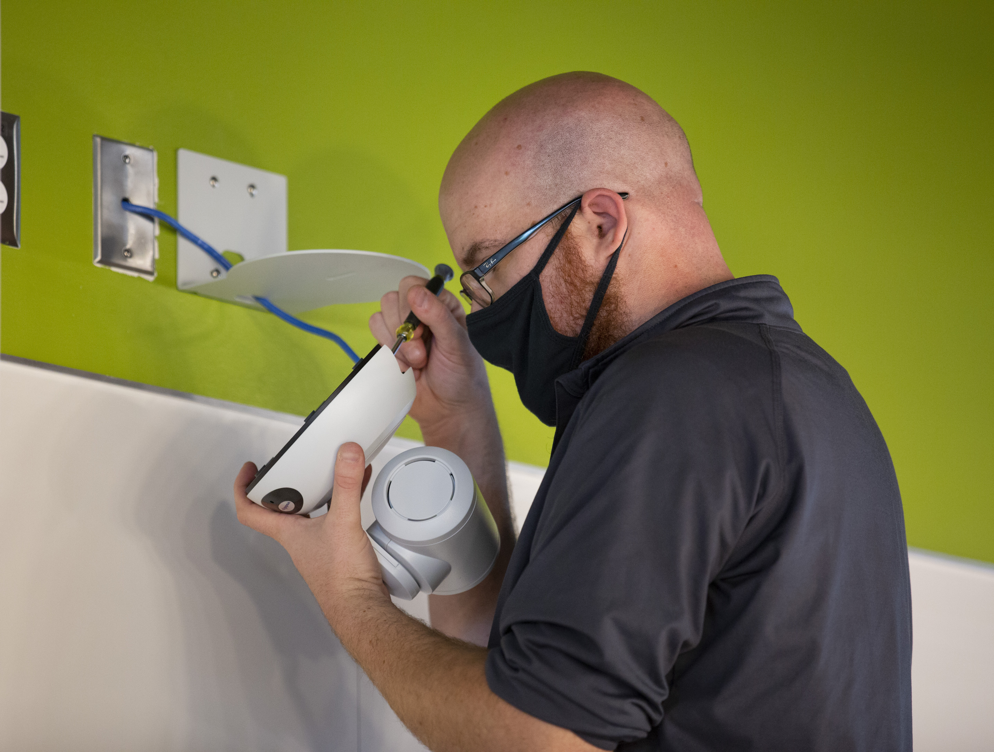
AV Integrator
Again, make connections for them
  Facilities, IT
  End users and stakeholders
  Don’t be a blocker
Be specific and directive
  In writing!
Admit when you’re out of your depth
Understand the change order process

Slide 34
Gifts for Friends!

Slide 35
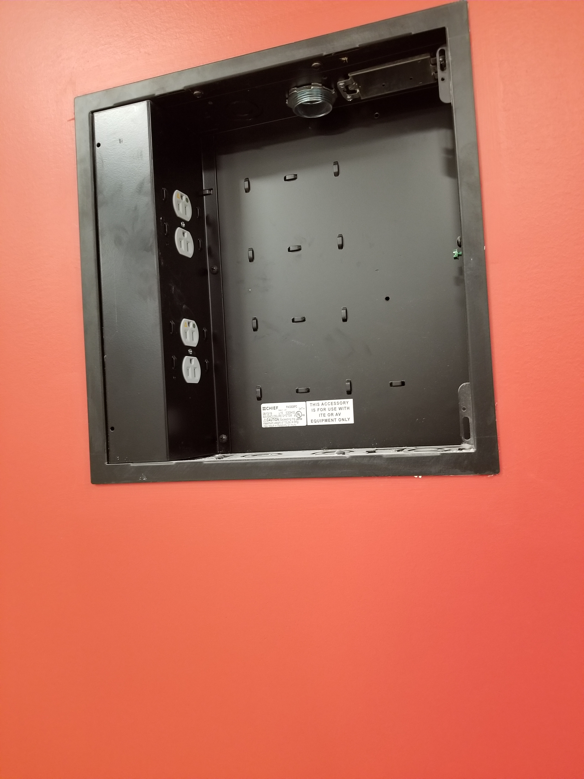
Infrastructure Standards
Theme
  Facility and construction infrastructure that supports audiovisual systems
Audience
  AEC Design Consultants
  Facilities Management
  General Contractors

Slide 36
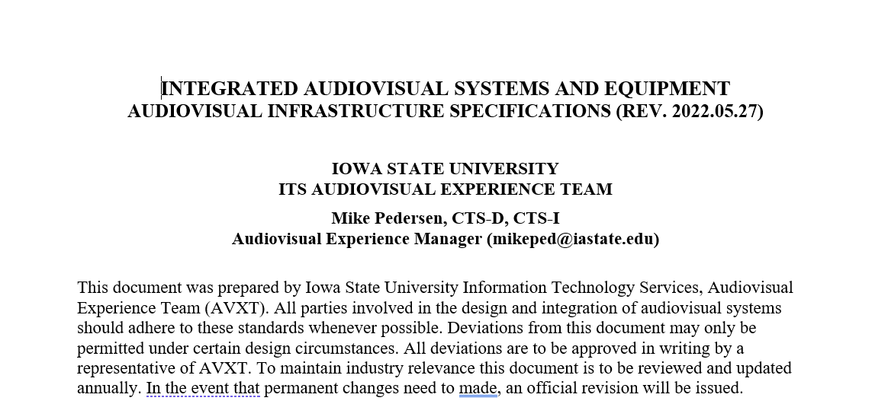
Infrastructure Standards
Content
  What does a GC need to provide for a successful AV install?
  Drawings worth 1000 words
Breakdown
  Coordination (e.g. clean room prior to AV install)
  Conduit/raceway/junction boxes
  Electrical / lighting
  HVAC
  Projector / screen needs
  Flat panel display needs

Slide 37
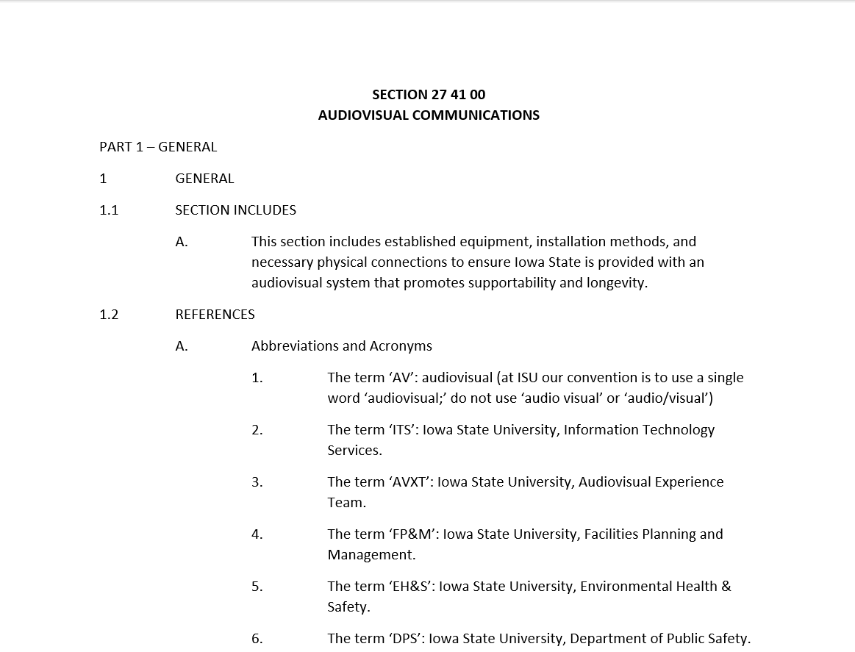
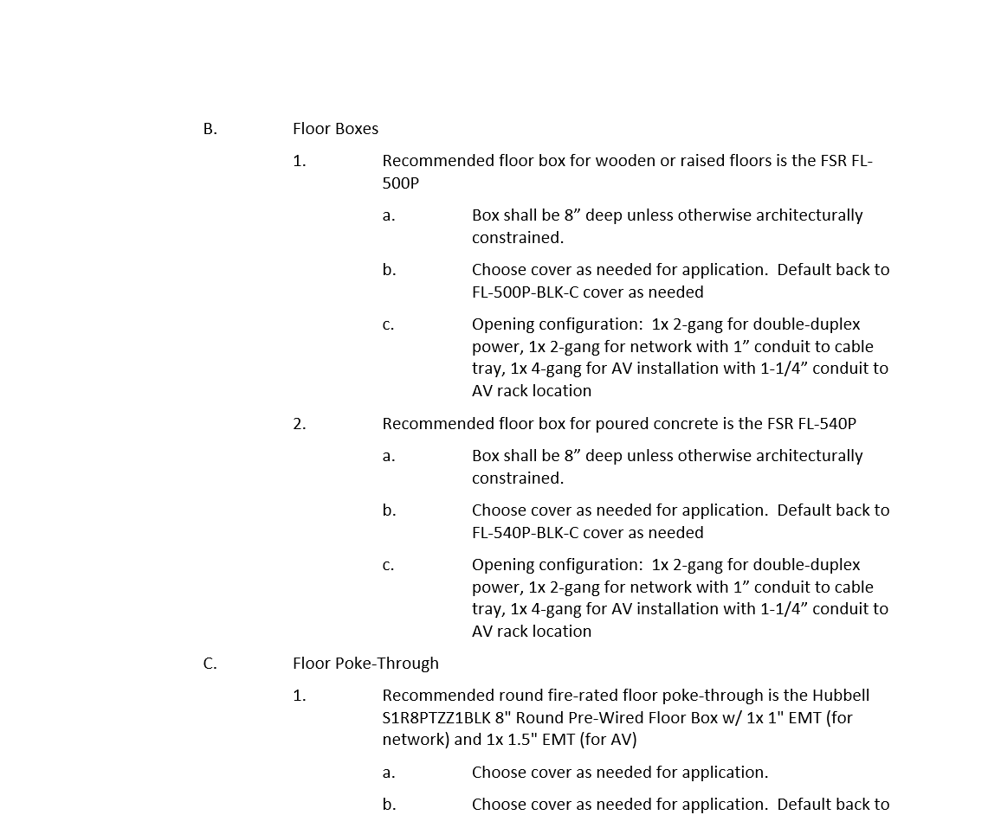
MasterFormat

Slide 38
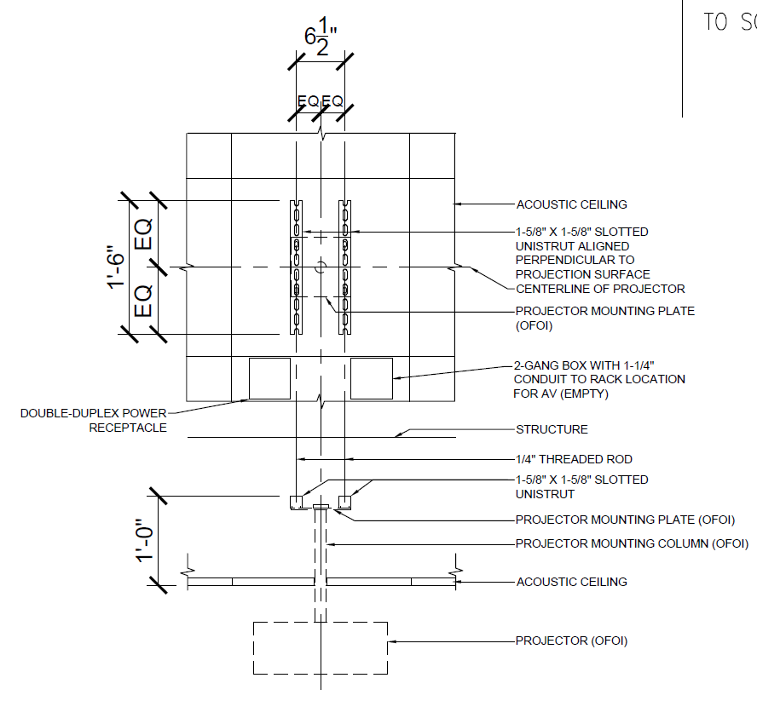
Standard Details
Standard details will endear you to everyone
Types of details
  Flat panel display mounting
  Projector mounting
  Screen mounting
  Rack locations
Do them in AutoCAD (or get them transferred to AutoCAD)
  Provide both .dwg (AutoCAD) and PDF copies

Slide 39
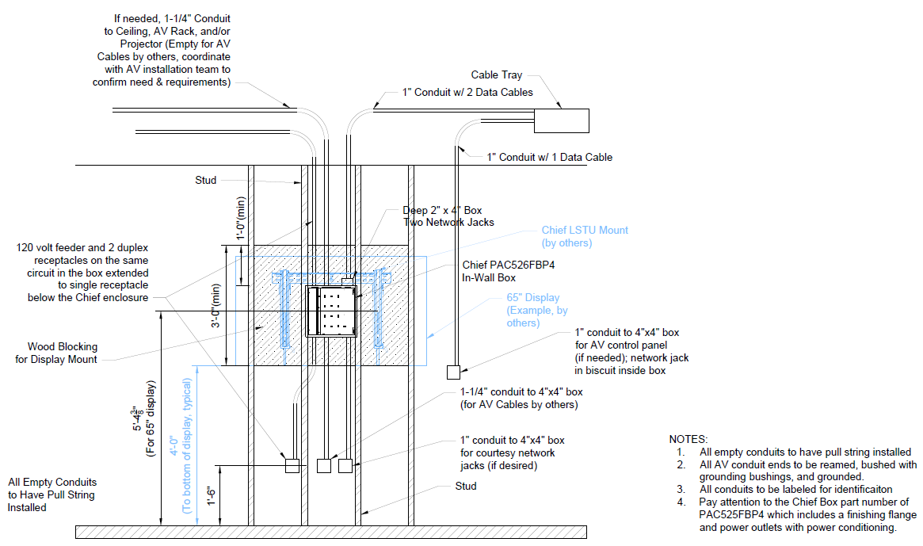

Slide 40
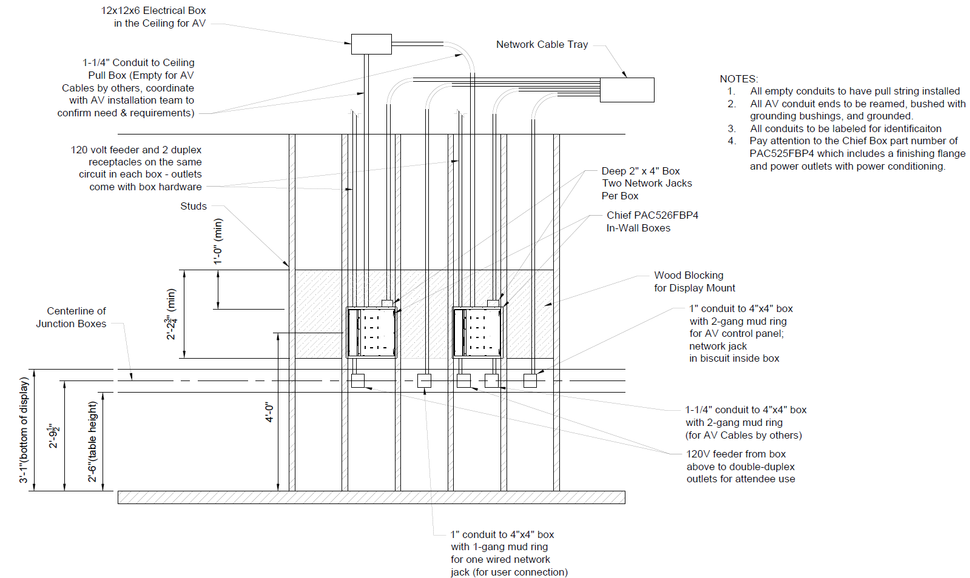

Slide 41
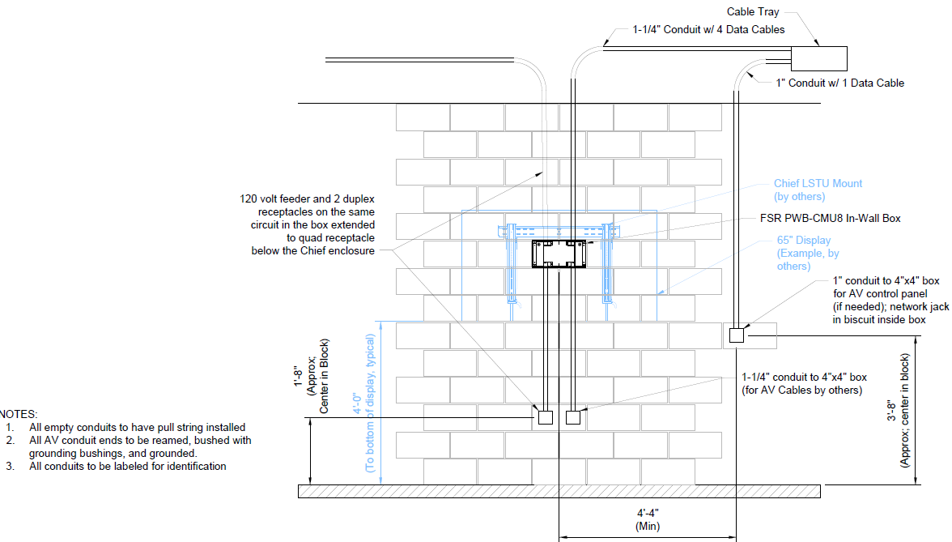

Slide 42
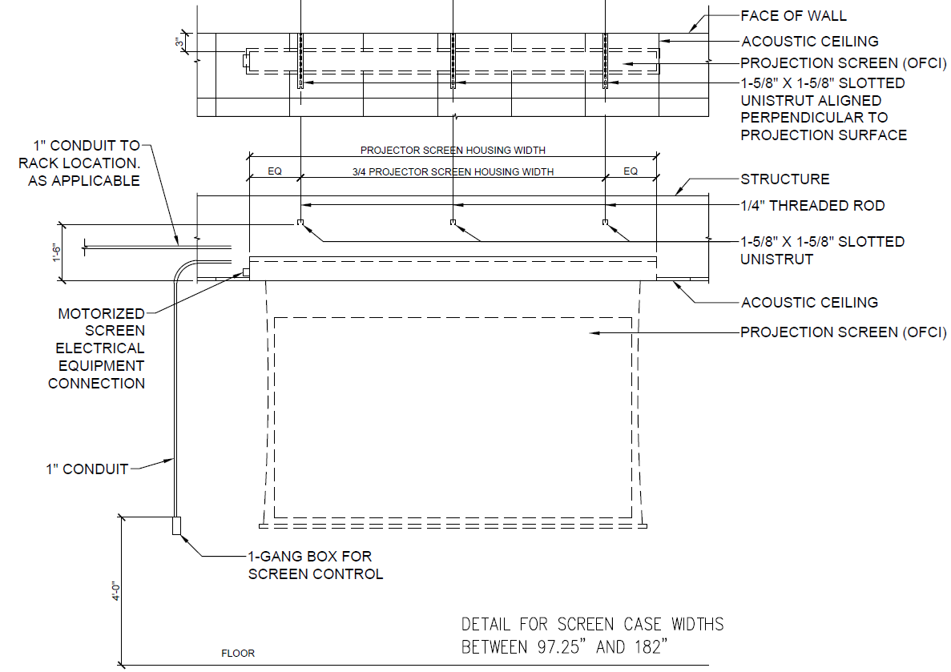

Slide 43
Keys to Successful Capital Projects
Engage, Support, and Verify

Slide 44

Engage
Engage prior to projects starting!
Introduce yourself
Set your standards
Ask for a seat
Ask questions
Understand their process

Slide 45
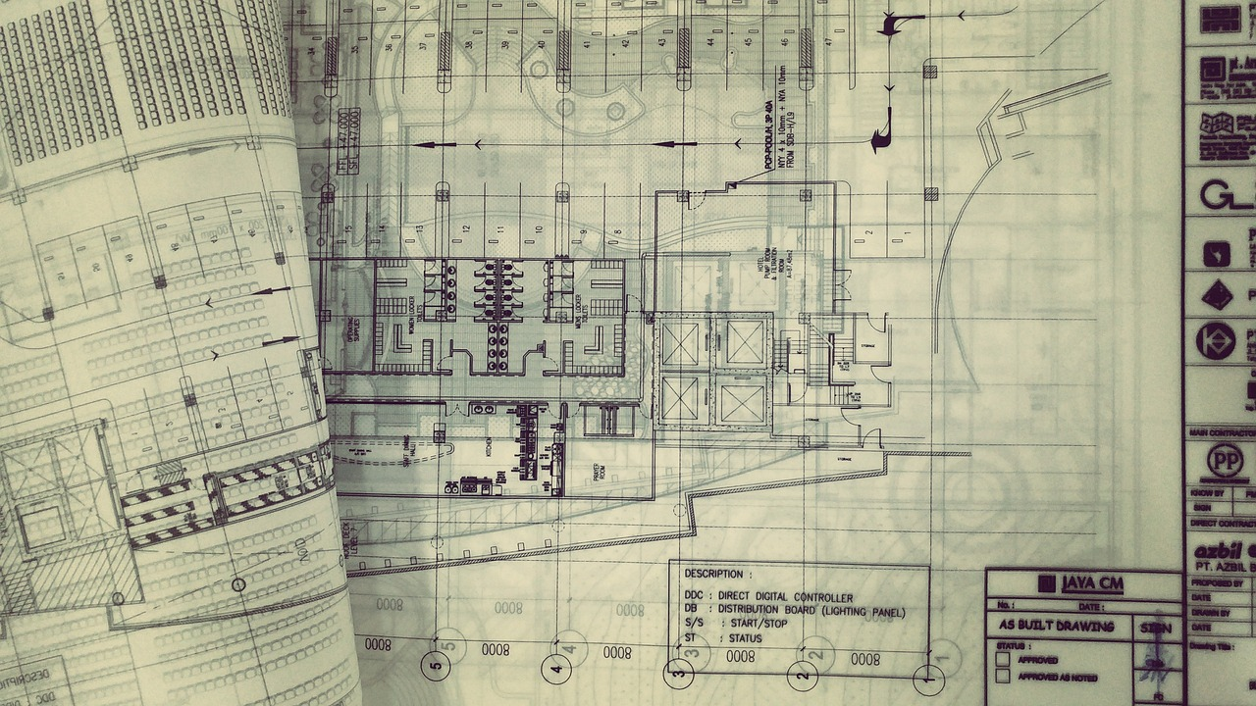
Support
Attend meetings
Provide feedback
  Design reviews
  Bluebeam
Be a translator
Support the project

Slide 46

Verify
Review final CD documentation carefully
Regular construction site visits
Confirm AV infrastructure is in place
Report deficiencies

Slide 47
A Success Story

Slide 48
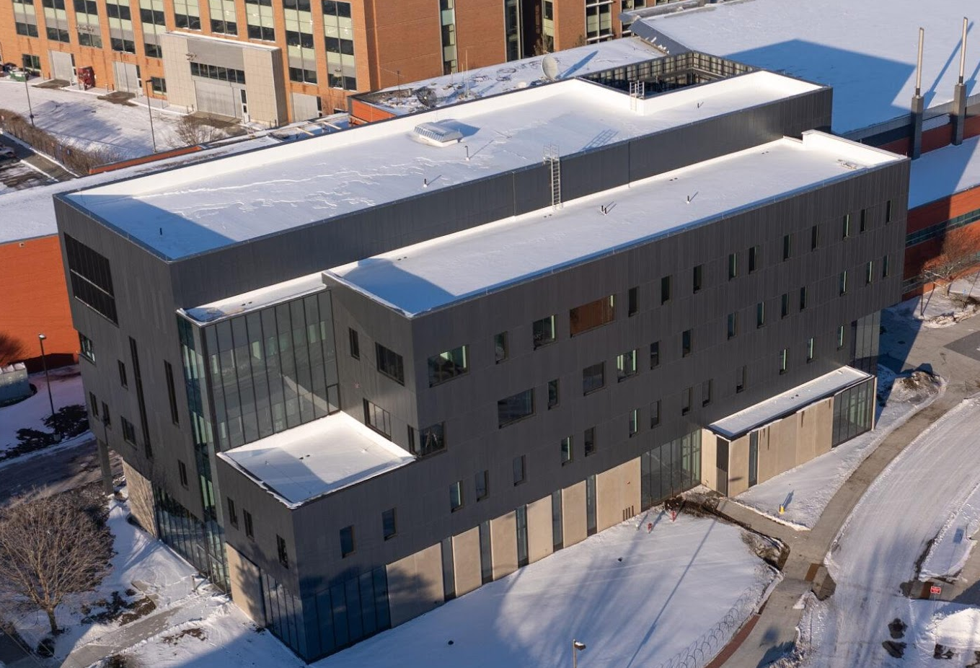
Therkildsen IMSE Building
Industrial and Manufacturing Systems Engineering
New Building Opening in 2025; ~80,000 SF
Detailed design work occurred in 2022-2023
In-House AV Team Engaged in 2021

Slide 49
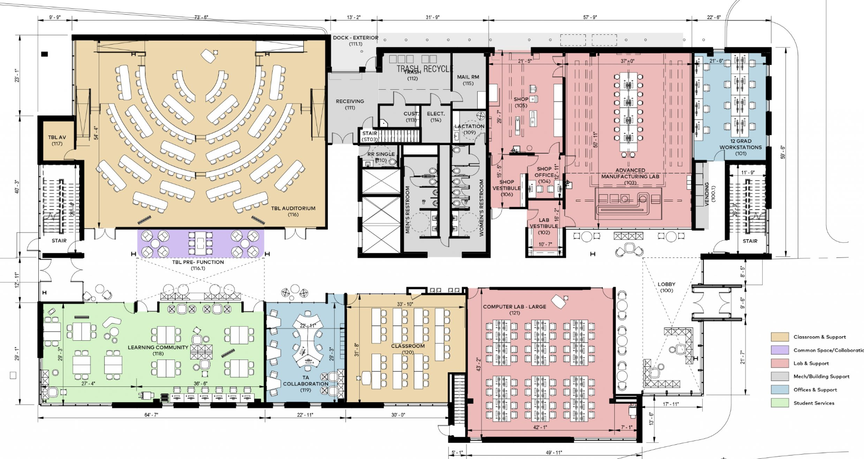
Good From the Beginning
ISU AV experts involved very early – room data sheets
ISU AV team has a strong relationship with the FP&M PM & CM
AV Involved in major design reviews

Slide 50
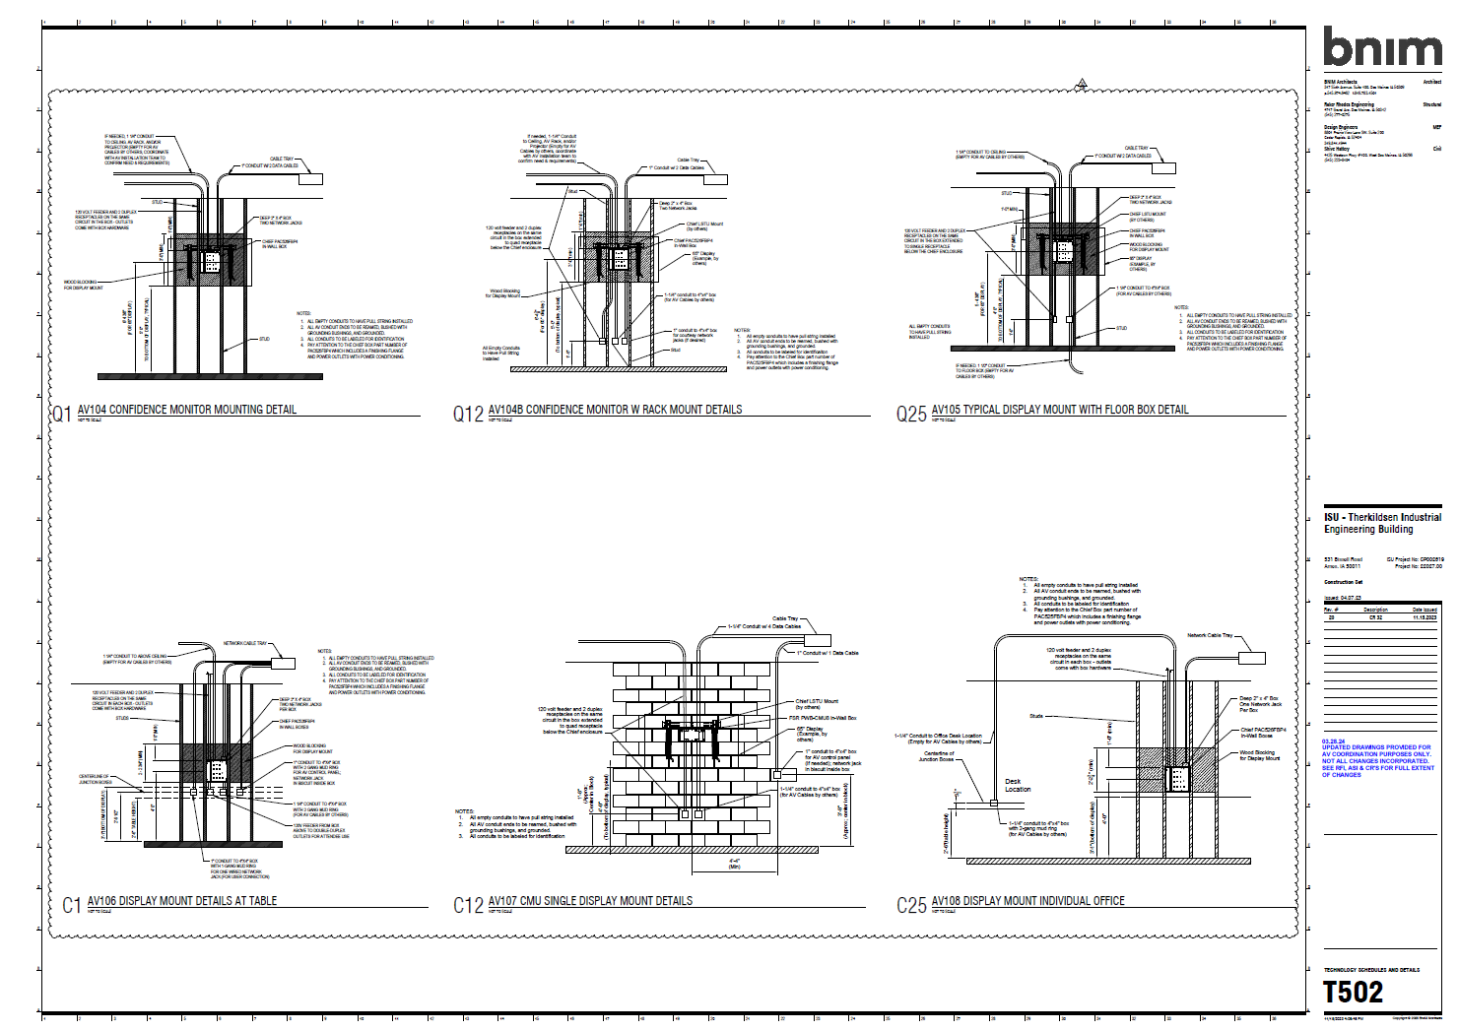
What To Do
AV infrastructure details developed by ISU AV team included in construction drawings
AV team forcing stakeholder meetings
Infrastructure done right the first time

Slide 51

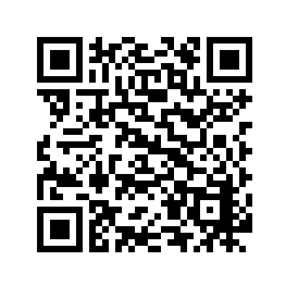
Contact Us
Questions?
Mike Pedersen
mikeped@iastate.edu
@ped1971
Desk: 515-294-9063
Josh Hamon
josh.hamon@stantec.com
206-224-3620
LinkedIn

