Slide 1

Designing for the Human Factors of AV
NW/MET
May 1, 2025

Slide 2

Agenda
About Me & Shameless Plugs
Human Information Processing Model
Seven Stages of Action
Overcoming the “Gulfs”
Q&A

Slide 3
About the Presenter
Mike Pedersen, CTS-D, CTS-I
Audiovisual Experience Manager
Audiovisual Experience Team (AVXT)
Information Technology Services (ITS)
Iowa State University
  Team Won Higher Ed AV Team of the Year in 2023
#InHouseIntegrator
7th Year at Iowa State University
19 Years at Audiovisual Integrator called Mechdyne Corporation

Slide 4
ETC
  Institutional Board Member
  Membership Committee
  Program Committee
  Hosted 2024 Annual Conference in Ames
AVIXA
  2018 CTS Holder of the Year
  Membership Committee
  CTS Renewal Committee
Higher Education Technology Managers Alliance (HETMA)
  Previous Board Member

Slide 5
Iowa State University
Public Land-grant University
Founded 1858
Fall 2023 Enrollment: 30,177
10 Schools and Colleges
100 Majors
World’s first electronic, digital computer invented here, 1942
Ames, Iowa
  #1 on 2019 US News Best College Towns
    https://www.usatoday.com/story/money/2019/09/07/best-college-towns-these-30-rank-among-30-top-us/2235088001/
  #1 Midwest on 2023 Research.com Best College Towns List
    https://research.com/universities-colleges/best-college-towns-and-cities-in-america

Slide 6
Shameless Plugs

Slide 7

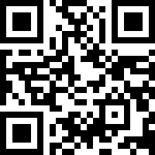
ETC
Educational Technology Collaborative (Formerly CCUMC)
Professional and leadership development
Outstanding collaboration
https://etc.memberclicks.net/

Slide 8

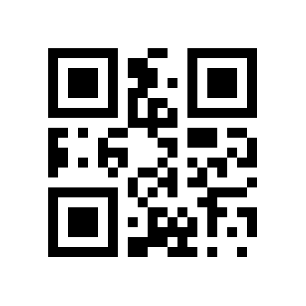
HETMA
Higher Education Technology Managers Alliance
Advocacy for Higher Ed within the Professional AV market
PRISM Scholarship
HETMA Approved Program
https://hetma.org

Slide 9
Human Factors

Slide 10
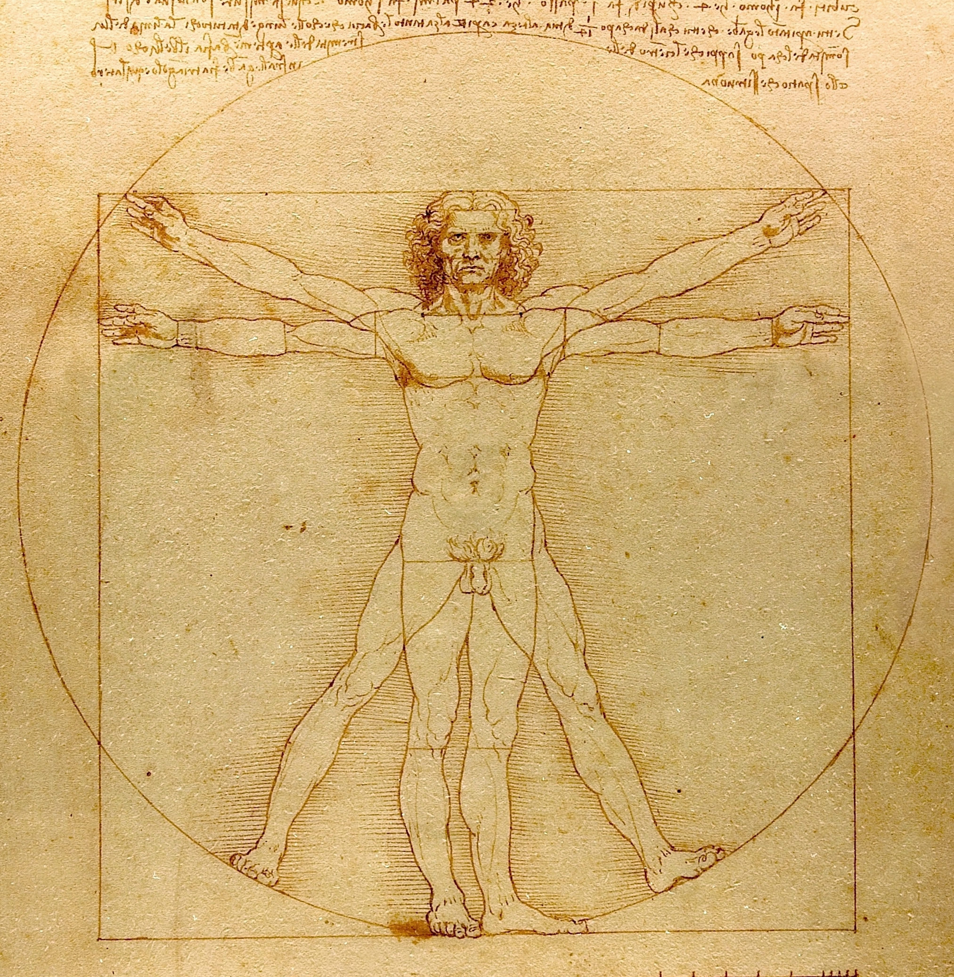

Human Factors
Human factors is a field dedicated to understanding human behavior and limitations and then appropriately designing technology systems that are:
  Safe
  Effective
  Efficient
  Free of errors
Two key principles of human factors:
  Know and honor thy user
  Recognition of individual differences

Slide 11
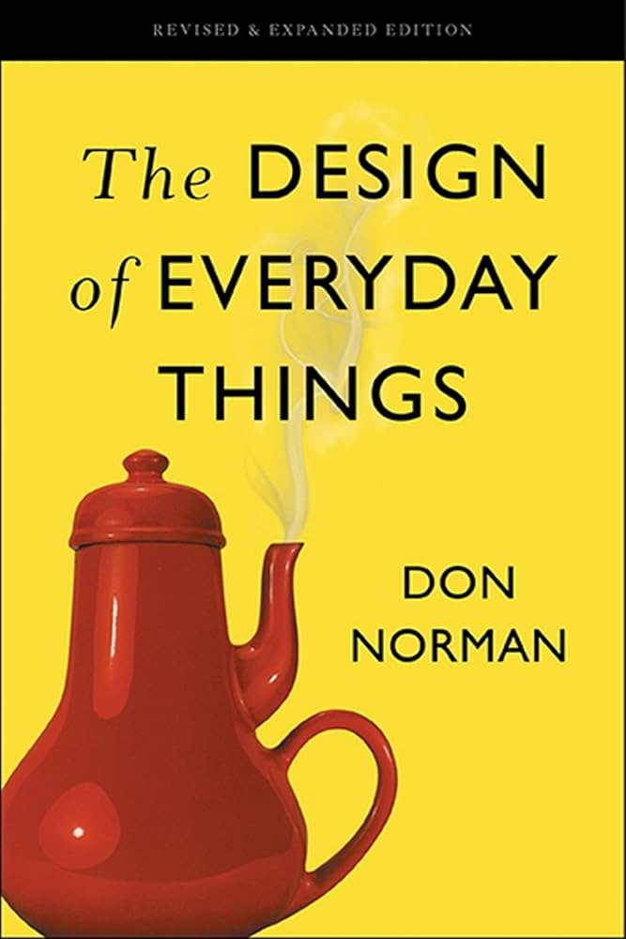
The Handbook
One key takeaway from the book is that there is no such thing as human error, it was just bad design.

Slide 12
Human Information Processing Model

Slide 13
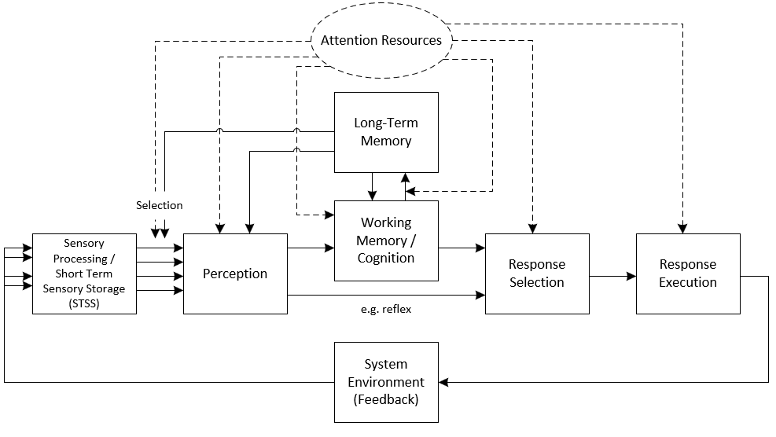
Human Information Processing Model

Slide 14





Sensory Processing
Humans have five basic senses:
  Visual
  Auditory
  Olfactory (smell)
  Gustatory (taste)
  Haptic (touch)
However, others include proprioception/kinesthesis, vestibular, and temperature

Slide 15
Short Term Sensory Store (STSS)
Each sense has a certain residual “memory” that does not require any attention resources – called sensory registry
  Holds information after stimulus has ended
  Short – visual possibly 1 second; auditory – 100-300ms
Attention resources needed to move information from the registry to perception
Then long-term memory is needed to encode it into something known – “what is it?”

Slide 16



Top Down and Bottom Up Processing
Bottom up – people receive information about the world into their senses
Top down – people have an amount of expectancy from experiences in their past – need to take advantage of this

Slide 17
Top-Down Examples
See what you want to see or hear what you want to hear
Read the following:
  Red, Green, Blue, Yellow, Purple, Orange
Now, read the following:
  Yellow, Green, Red, Orange, Blue, Purple
Without any other context, what do these colors represent:
  Red
  Green
What do these shapes represent:

Slide 18
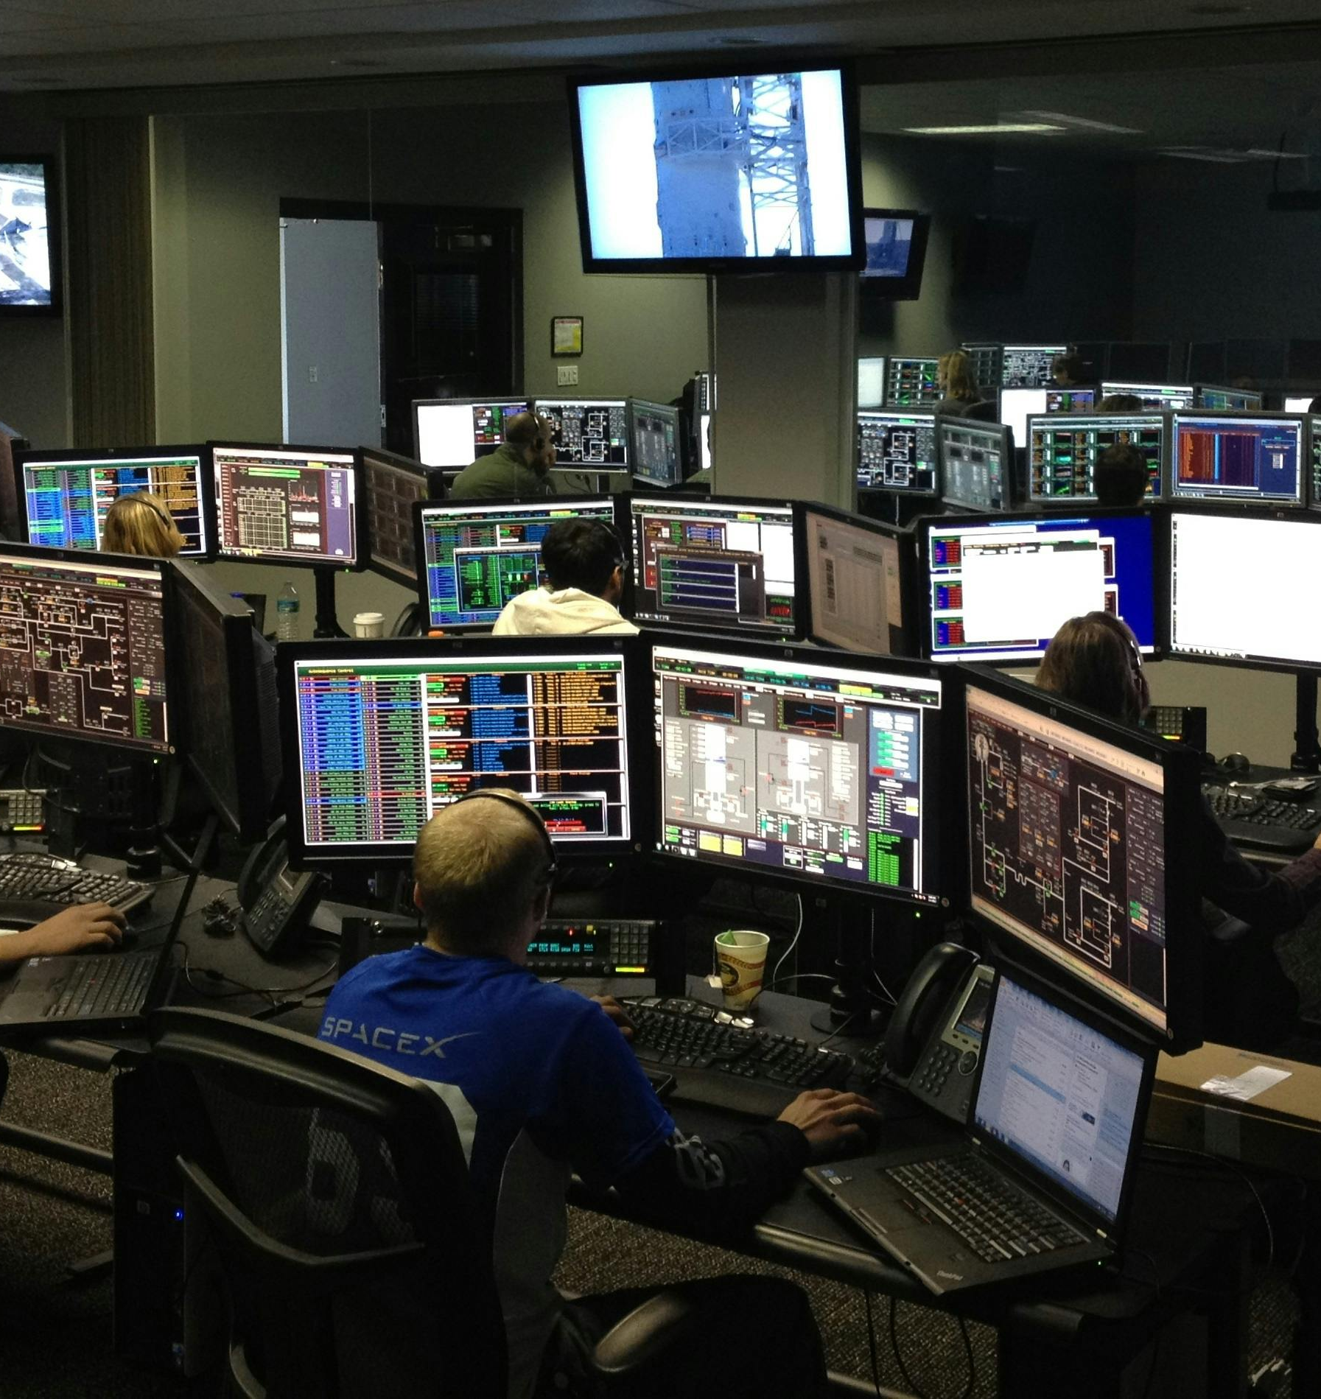
Situational Awareness
Level 1: Perception
Level 2: Comprehension
Level 3: Projection of current understanding onto future states

Slide 19
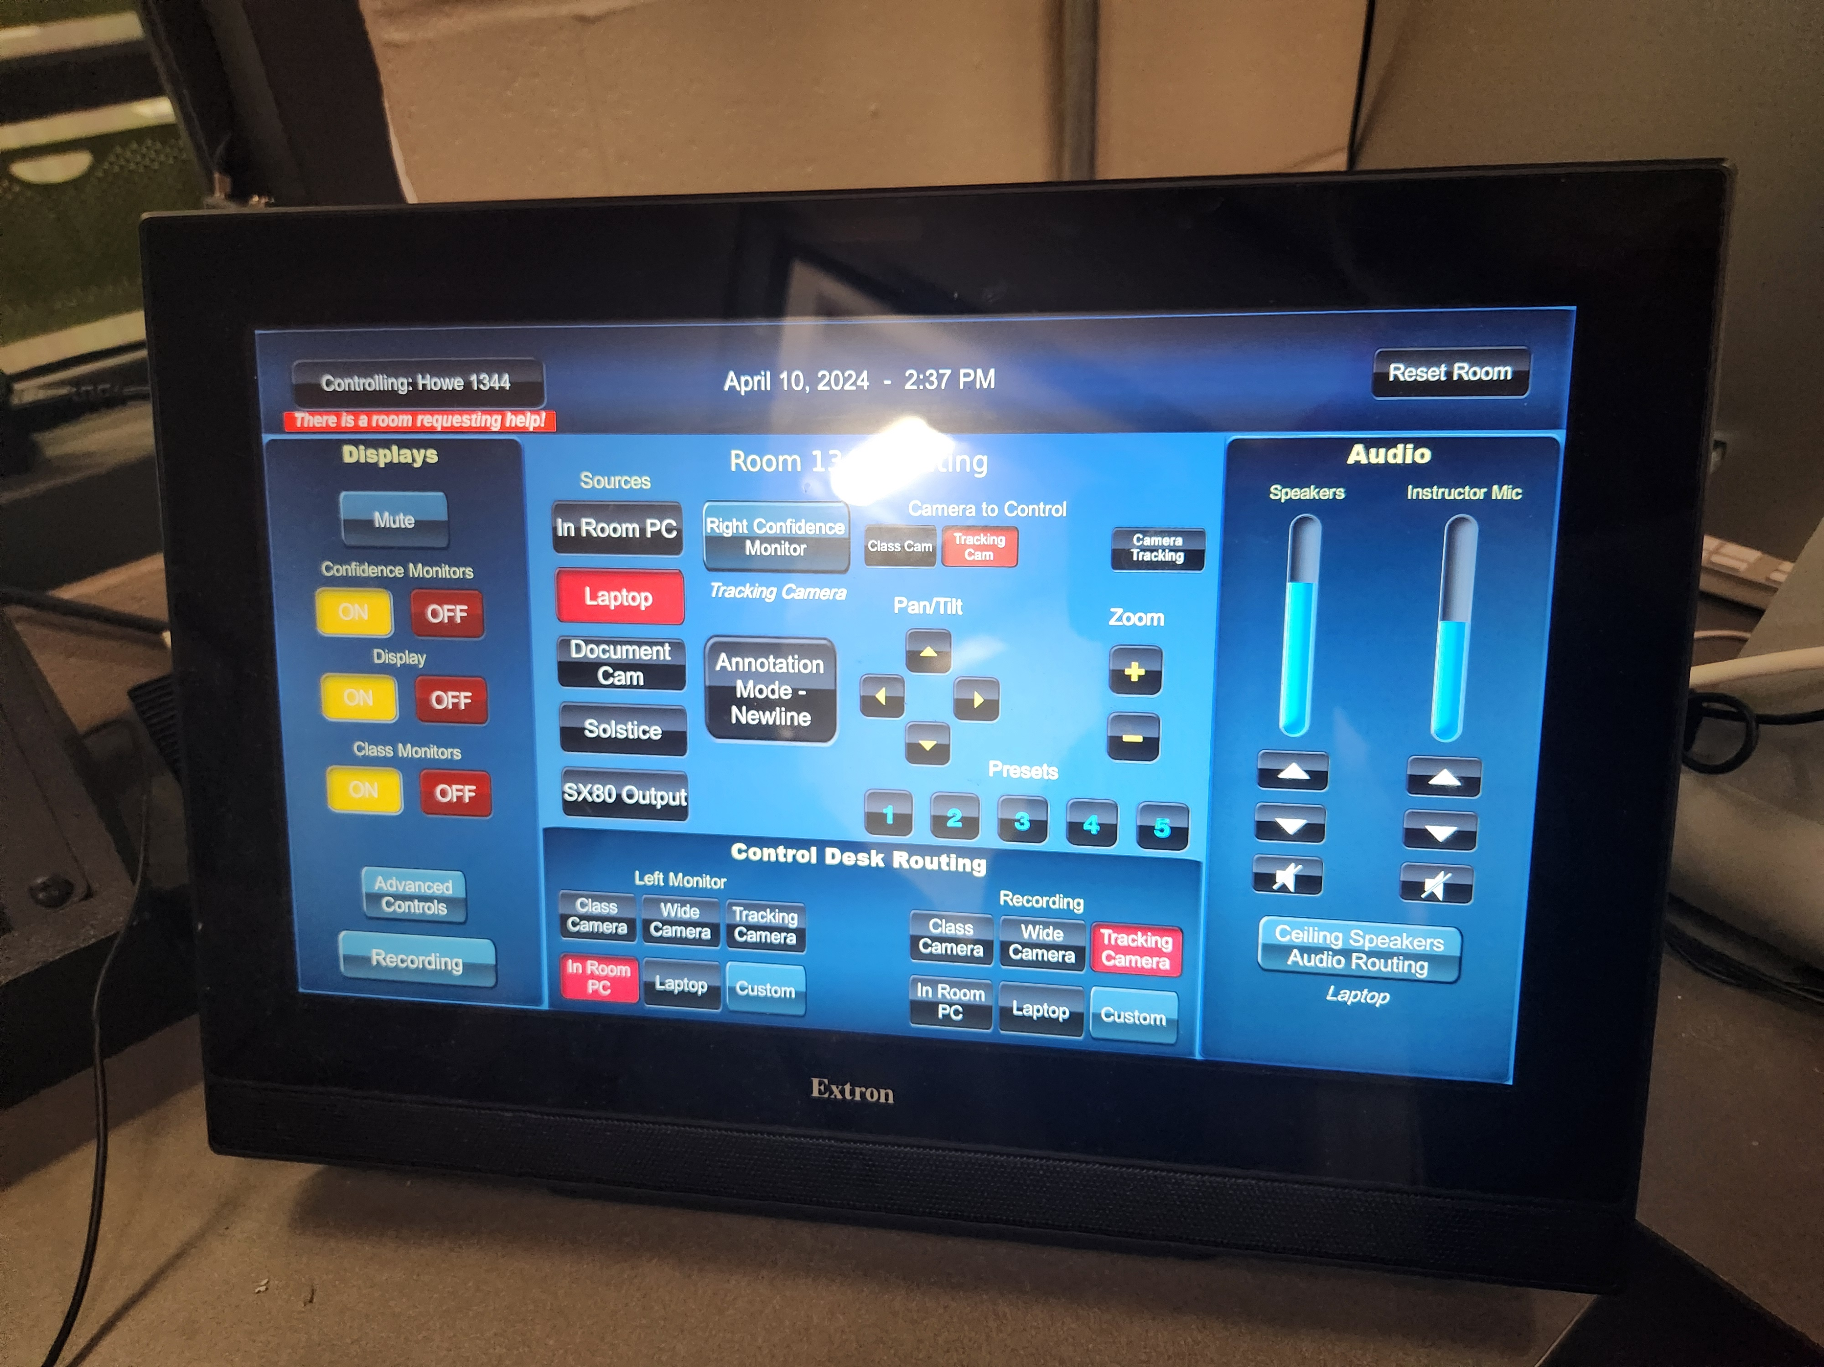
Situational Awareness

Slide 20
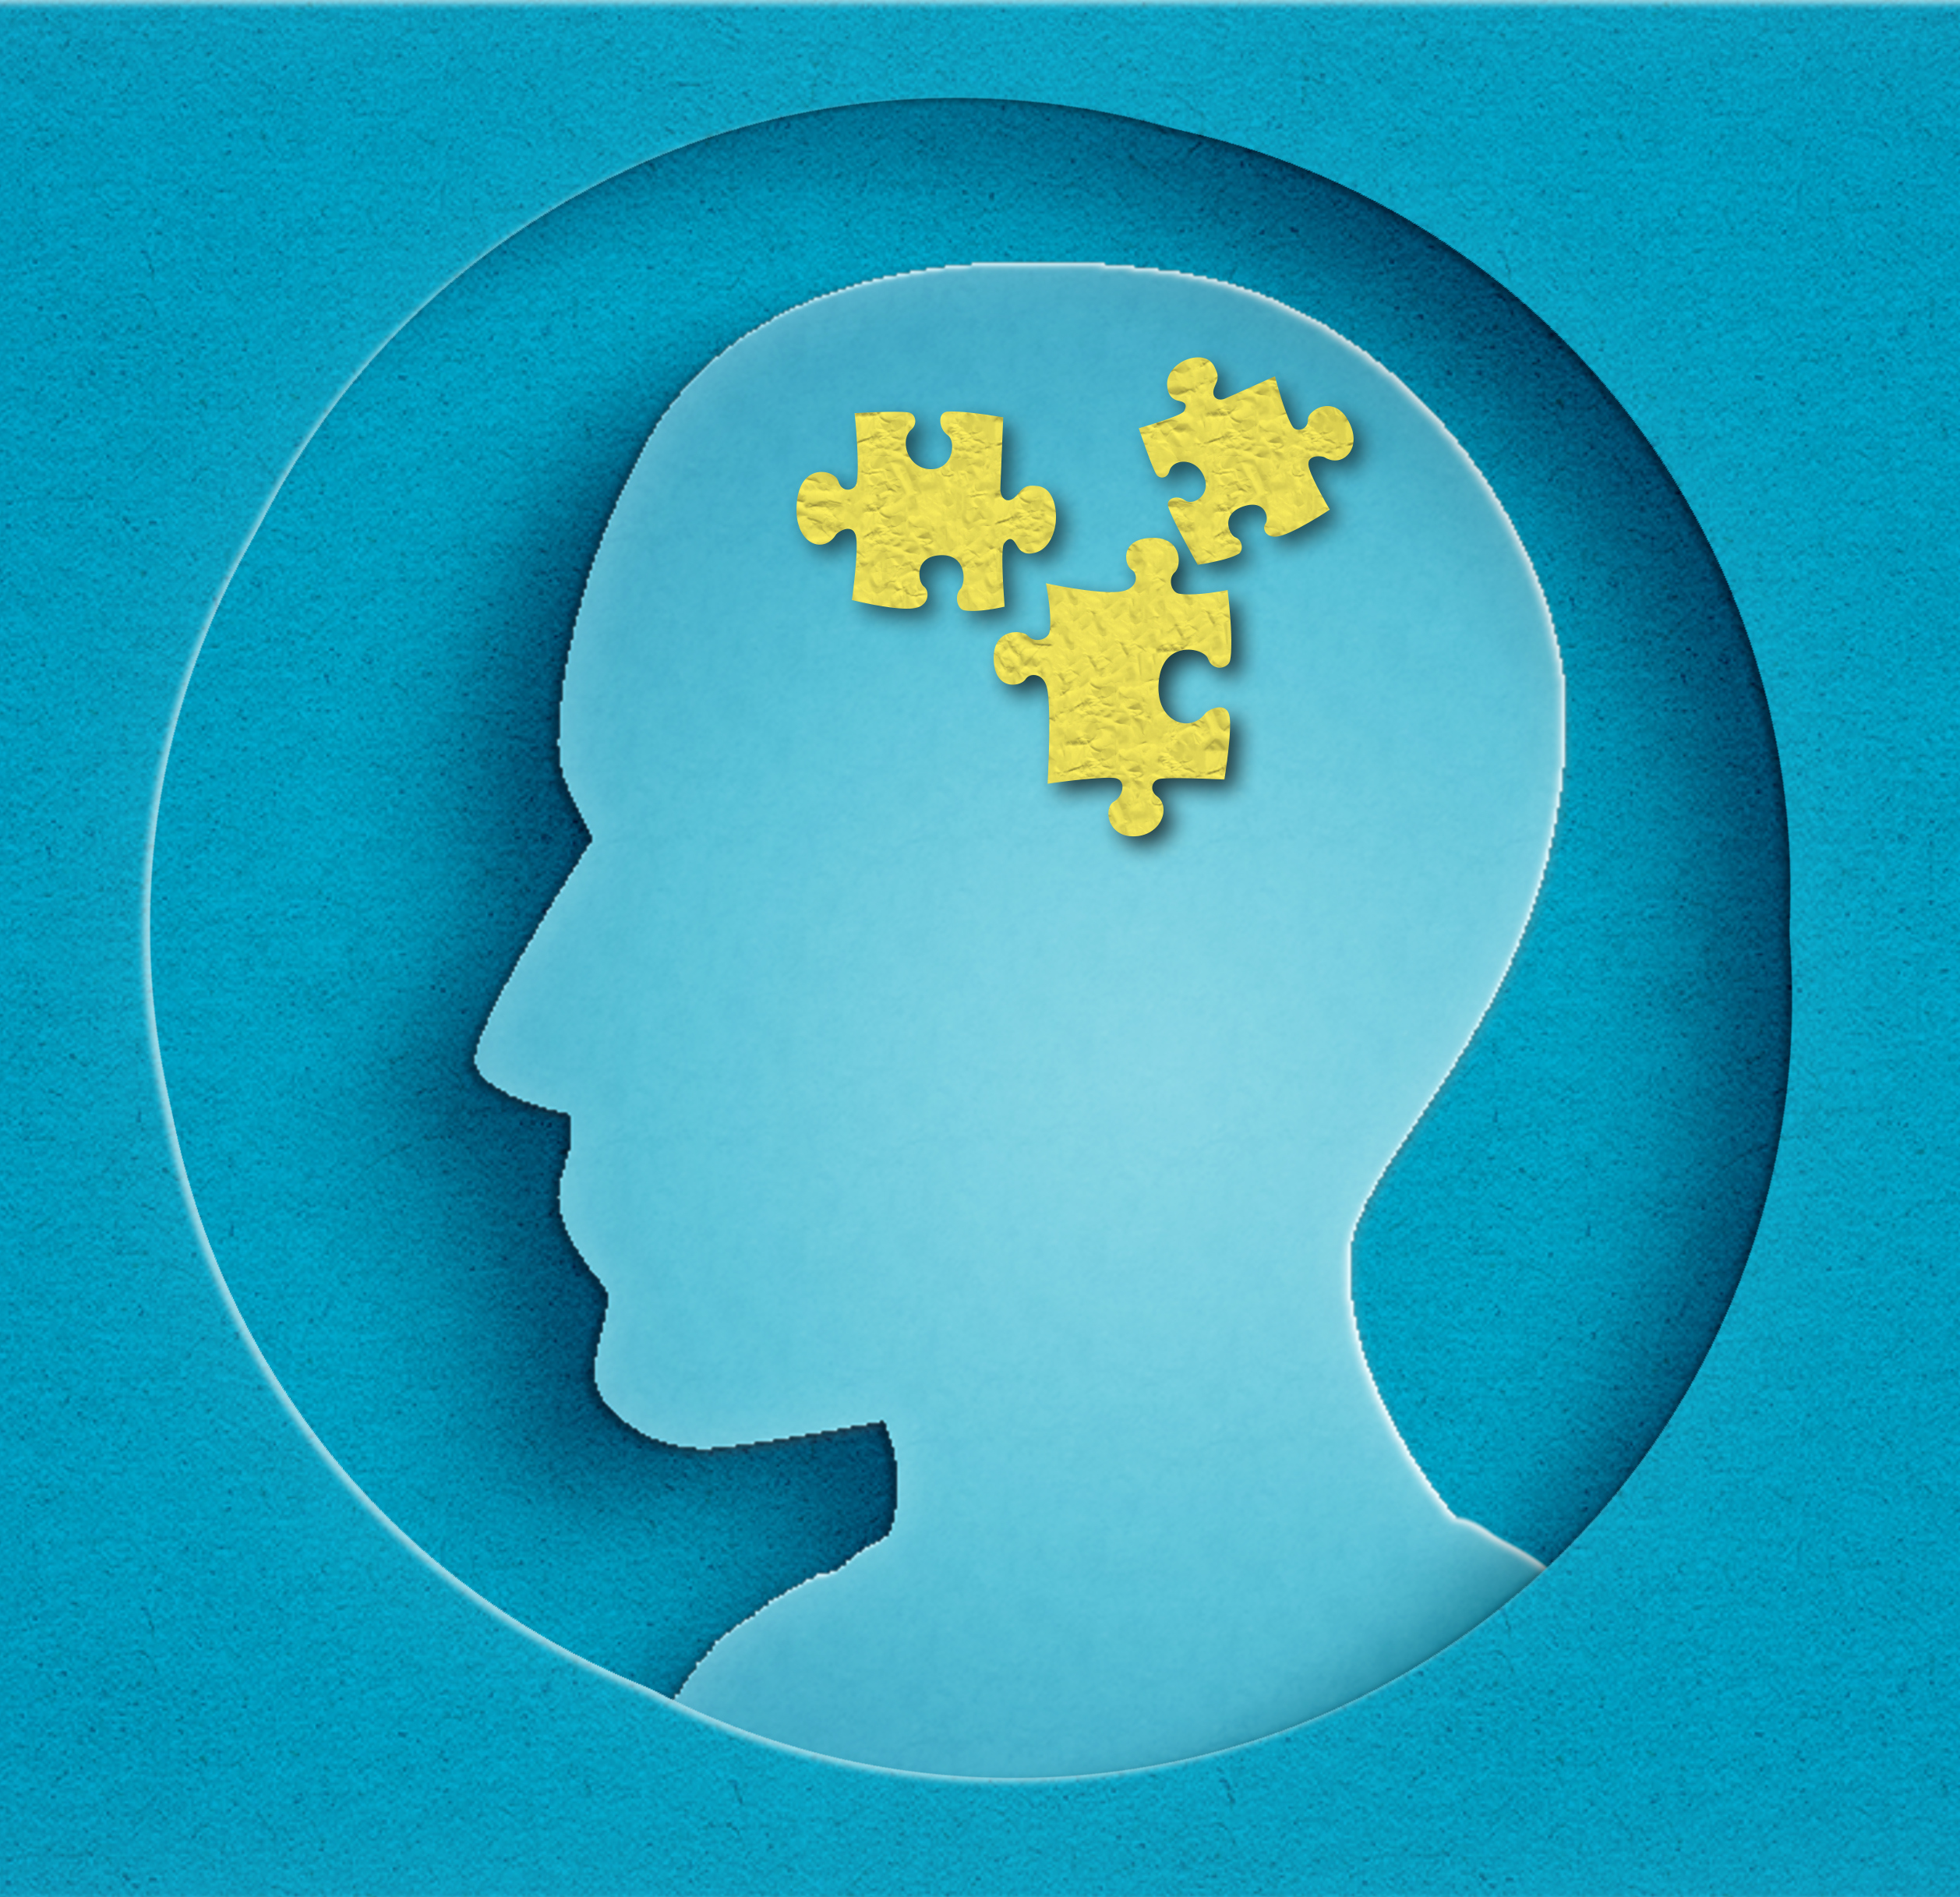
Biases
Heuristics
  Heuristics = mental short-cut
  Humans have limitations, so we take advantage of simplifications
Types:
  Representativeness
  Availability
Biases
  Overconfidence Bias
  Anchoring Heuristics
    First Impressions
  Confirmation Bias

Slide 21
Seven Stages of Action

Slide 22
Seven Stages of Action
Show Laptop on Projector
Goals
Decide to Act
Sequence of Actions
Execute Actions
World
Perceive State of the World
Interpret Perception
Evaluate
Decide to turn on AV system
Is my laptop image on the screen?
Green indicator means what? Source button highlighted means what?
Determine the steps to take
See indicator on touchpanel? See projector turning on? See laptop image on screen?
Push buttons on touchpanel
User, Room, and AV System

Slide 23
Human Information Processing Model

Slide 24
Gulf of Evaluation
Goals
Decide
Seq.
Execute
World
Perceive
Interpret
Evaluate
?
Can I perceive, interpret, and understand the state of the system?
  Can I see (or hear, feel, touch) an indicator?
  If so, do I understand what the indicator means?
  How does it relate to my goal?
  Relates to situational awareness

Slide 25
Gulf of Execution
Do I know how to achieve my end goal?
  What actions are even possible? Can the system even do what I want?
  Do I understand the sequence of steps?
  Are the barriers to me physically being able to execute the actions?
    Can I reach the button?
    Is the button responsive to my touch?
Goals
Decide
Seq.
Execute
World
Perceive
Interpret
Evaluate
?

Slide 26
Overcoming the Gulfs

Slide 27

Overcoming the Gulfs
Evaluation
  Ensure the system provides the users information about the current state that is:
    Perceptible
    Meaningful
  Use solutions such as:
    Affordances
    Conceptual models
    Making things visible
    Giving feedback
    Mapping
Execution
  Ensure the system is designed such that actions are:
    Clear
    Able to be accomplished (supported)

Slide 28
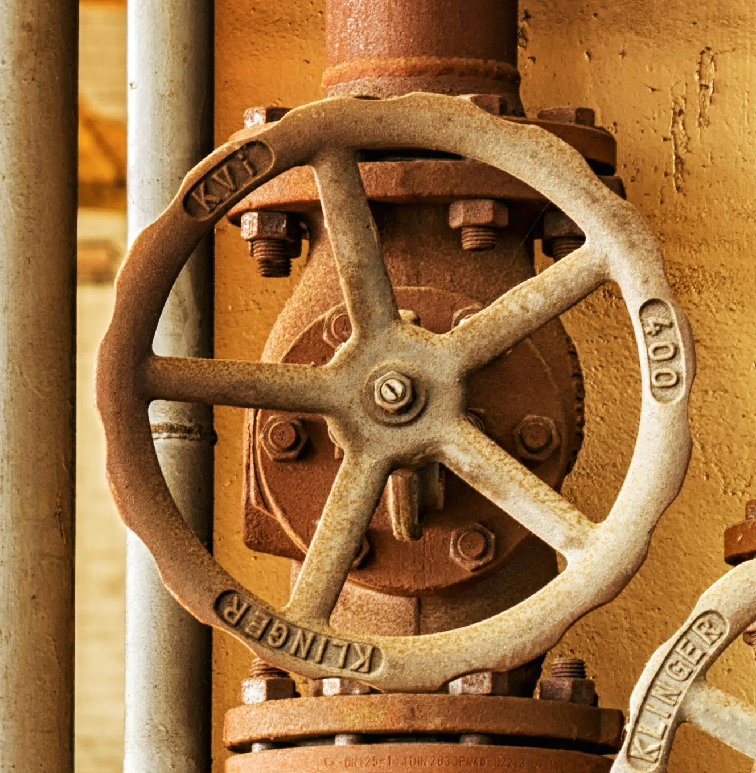



Affordances
An affordance is a perceived functional property of something – it’s shape, form, or structure provides a clue as to how it functions
Not a property – a relationship
A chair affords sitting
A handle affords pulling
A knob affords turning
A glass affords holding liquid

Slide 29
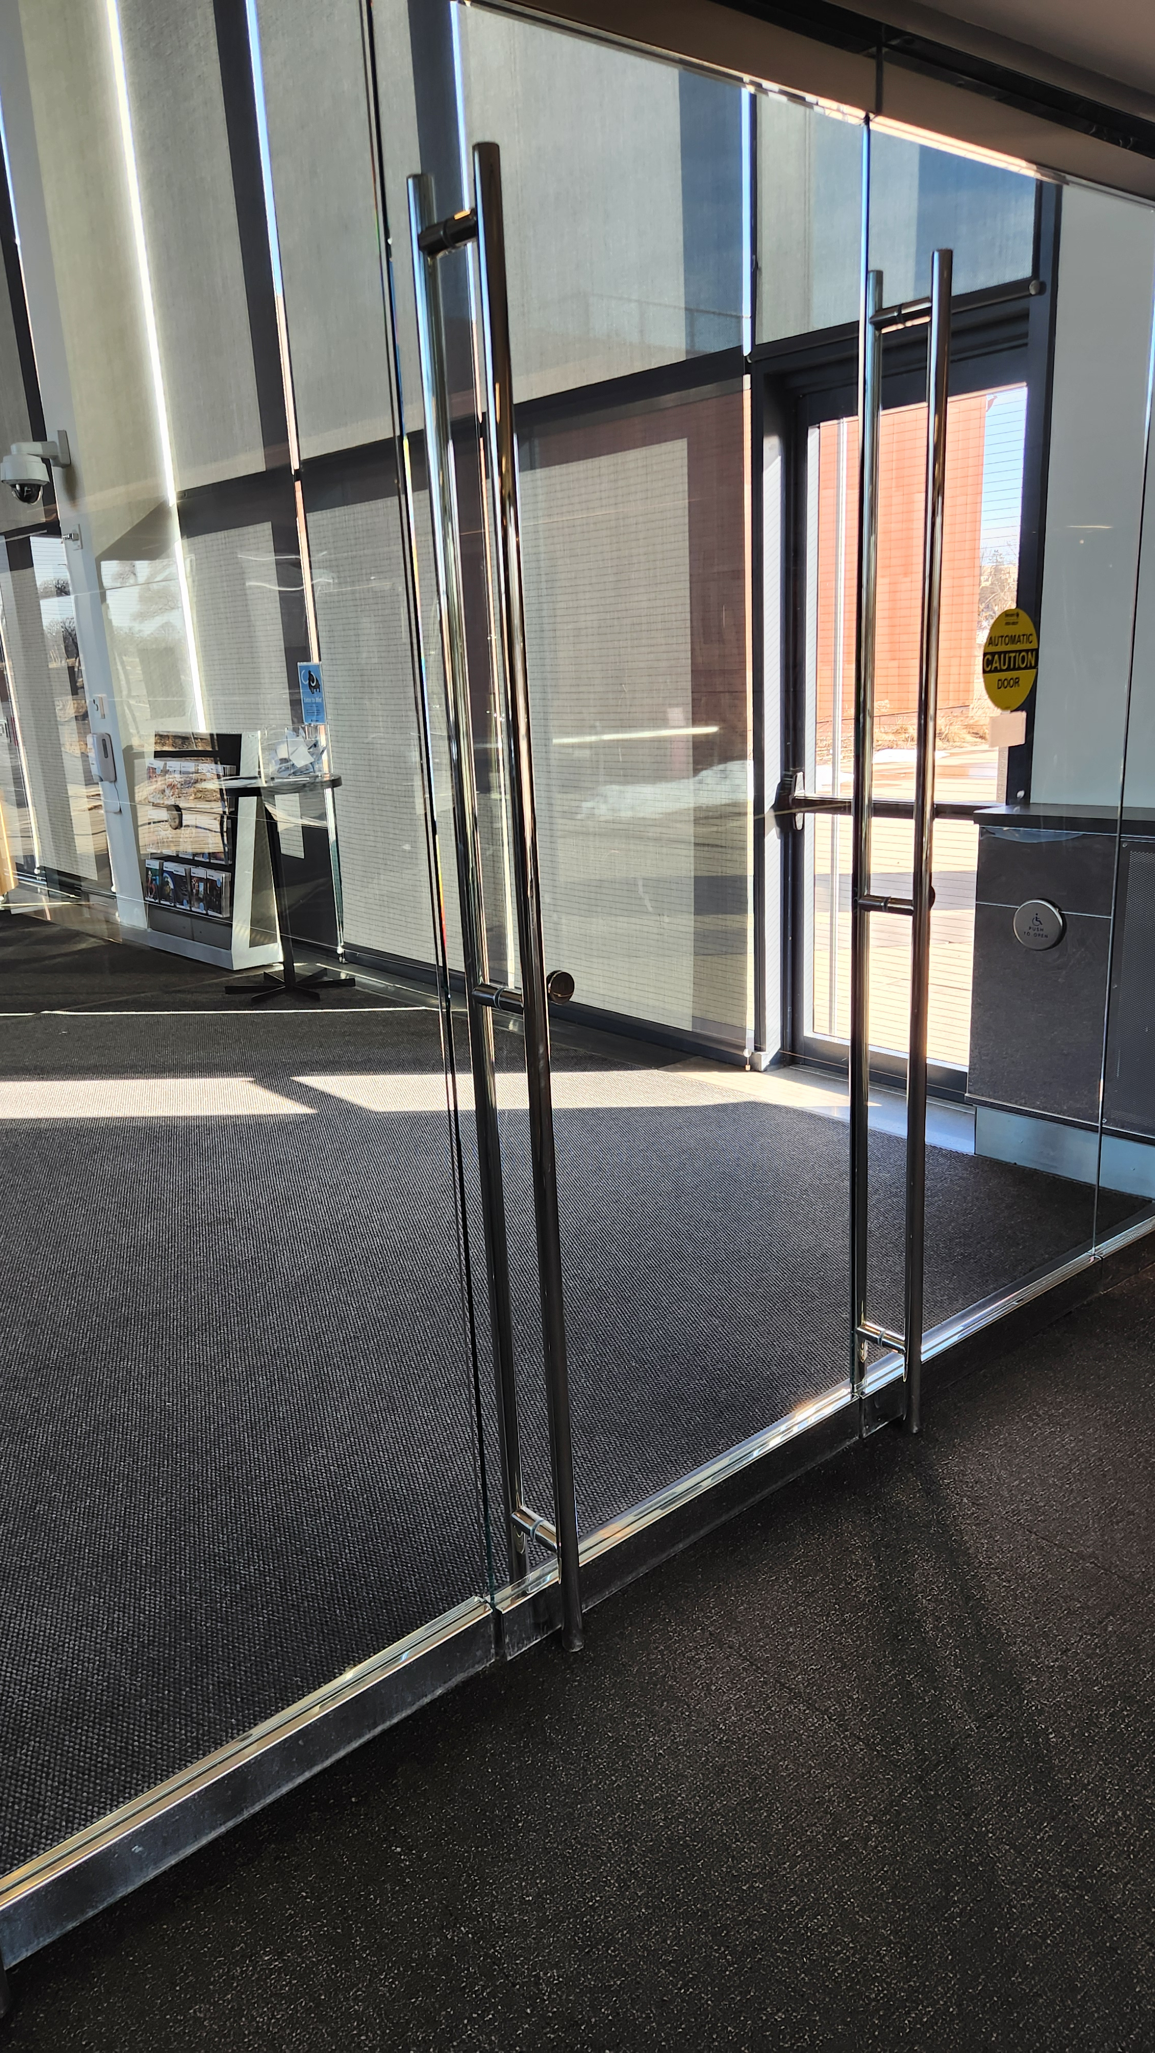

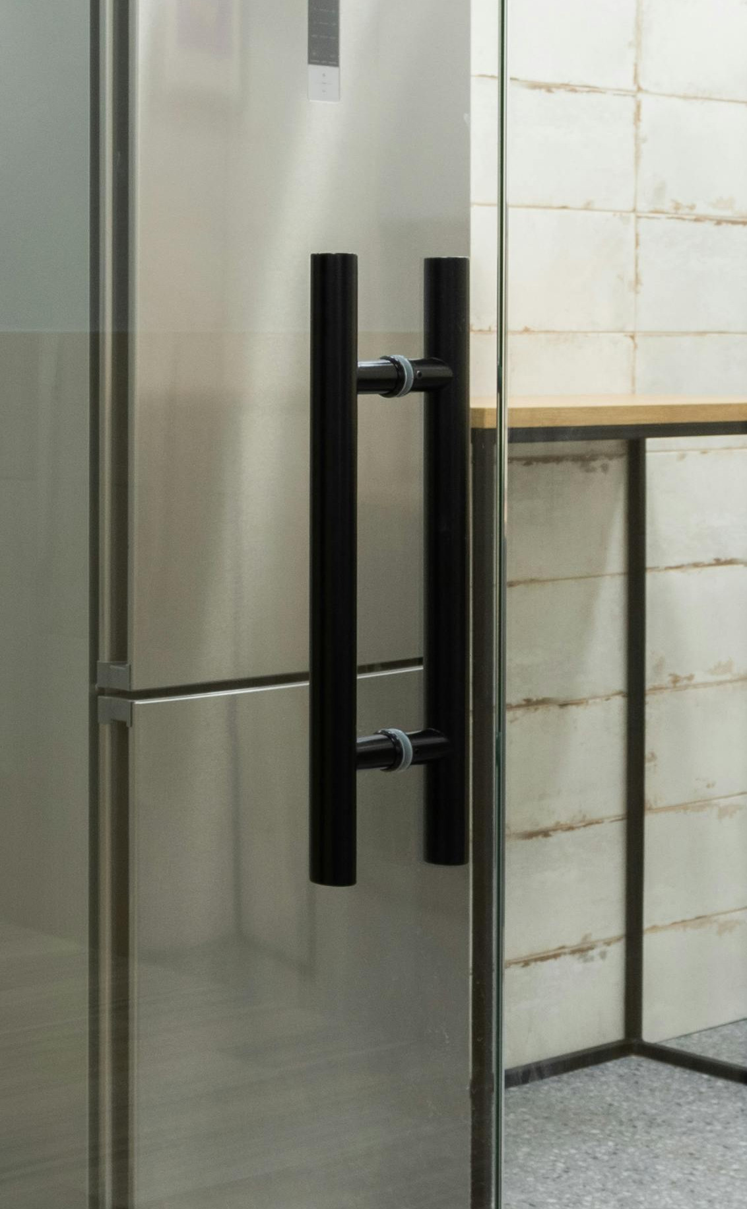
“Norman Door”
You walk up to a door – is it push or pull (or either)? The affordances are not clear.

Slide 30
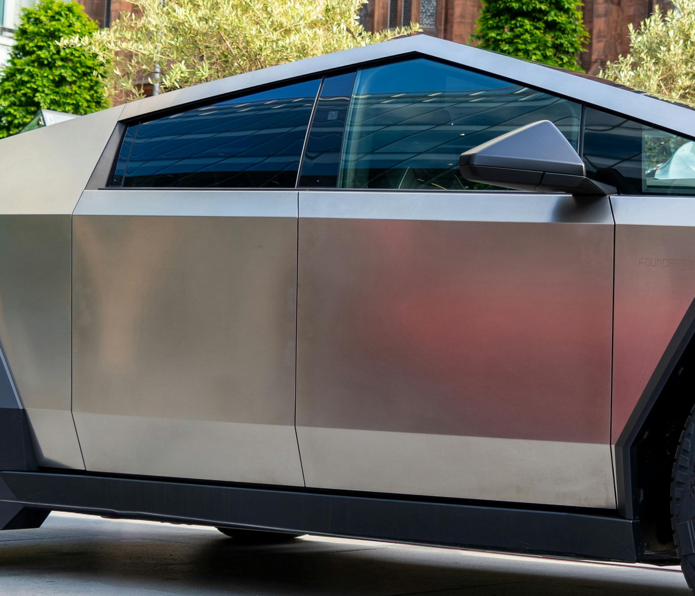
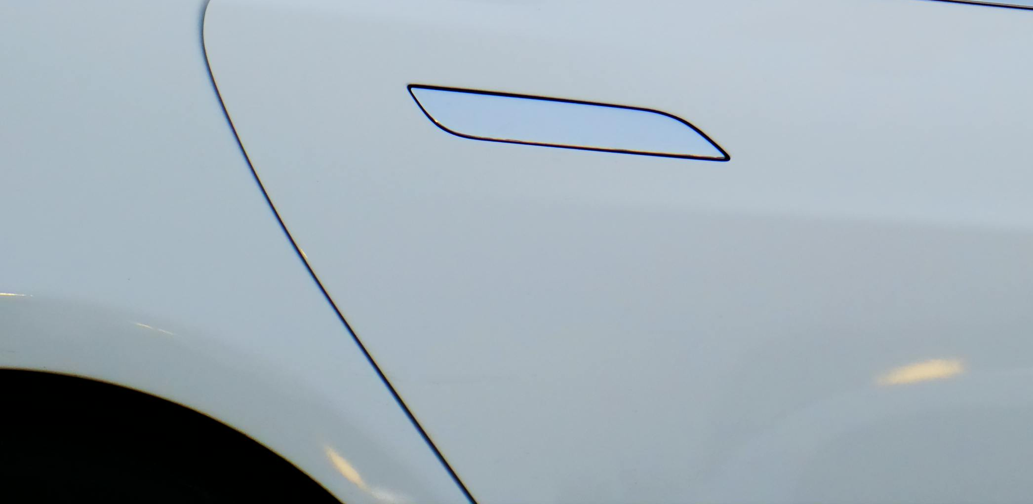
“Norman Doors”
How do these work?

Slide 31

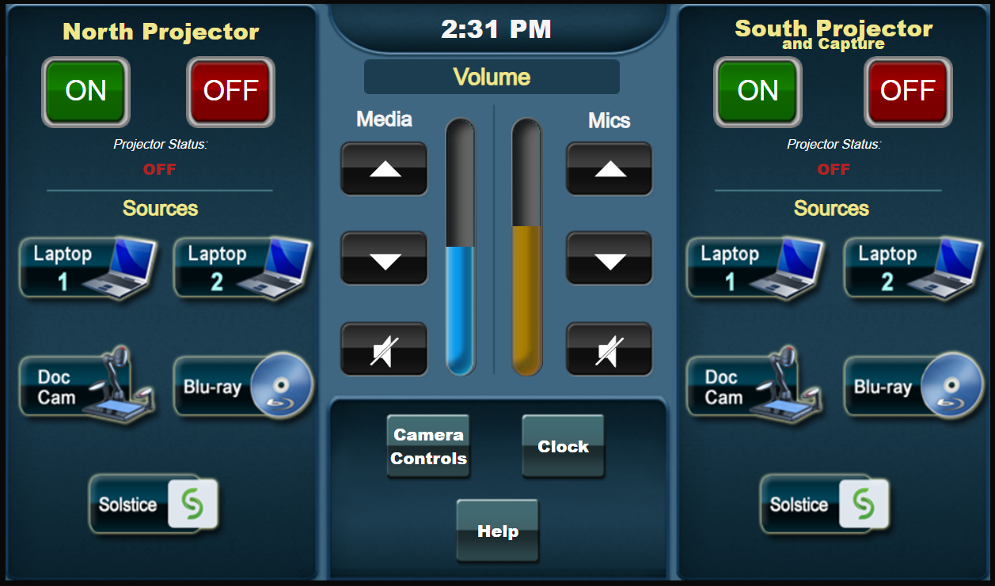

Signifiers
A signifier helps identify how to utilize an affordance
We can use signifiers to make functional options clear
Which one gives the best clue that it is something to be pushed?
Is this an indicator or a slider?
“Push” and “Pull” signs on ambiguous doors

Slide 32
Conceptual Models & Mental Models

Slide 33



Making thing visible
Legibility
  Color and contrast
  Can you read this easily?
  What about this?
Pictorial realism
  Should look like what it represents
  Iconography

Slide 34

Making thing visible
Principle of the moving part
“Put knowledge into the world” – Dr. Richard Stone

Slide 35
Giving feedback
The user needs near immediate feedback that their action was recognized (state change)
  A lag of even 100ms can cause challenges for inexperienced users
Per research, human beings prefer and do better with multimodal information (more than one sense, e.g. visual and auditory)

Slide 36
Giving feedback
When you press a button do you get?
Immediate color or text change?
Audible beep, tone, or click?
Tactile click or vibration?
Ideally, at least two each time
Goals
Decide
Seq.
Execute
World
Perceive
Interpret
Evaluate
?

Slide 37
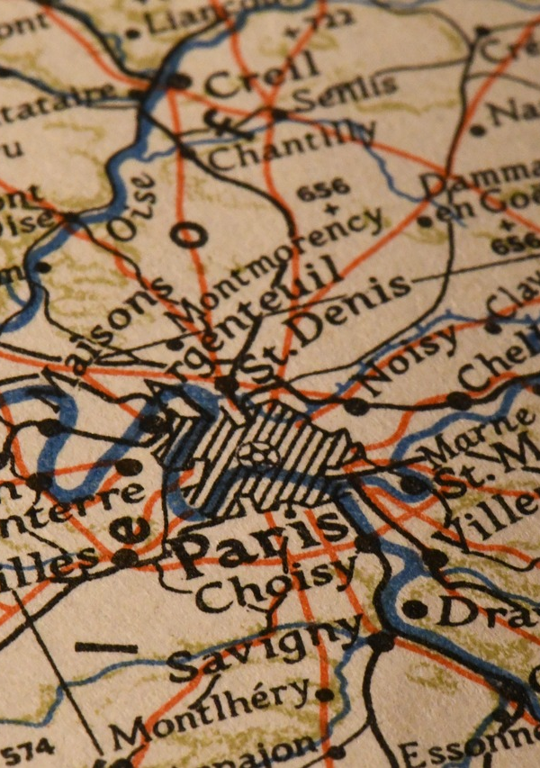
Mapping
Mapping is just as it sounds – replication of the spatial or positional relationship between things
Keys to map include:
  Controls to indicators/displays
  Controls to functions
For AV, the type of mapping used most would be called “natural mapping”
  Spatial – matching controls to controlled objects from a location perspective
  Functional - e.g. moving control up gives more of something (audio, light, etc.) and down gives less

Slide 38
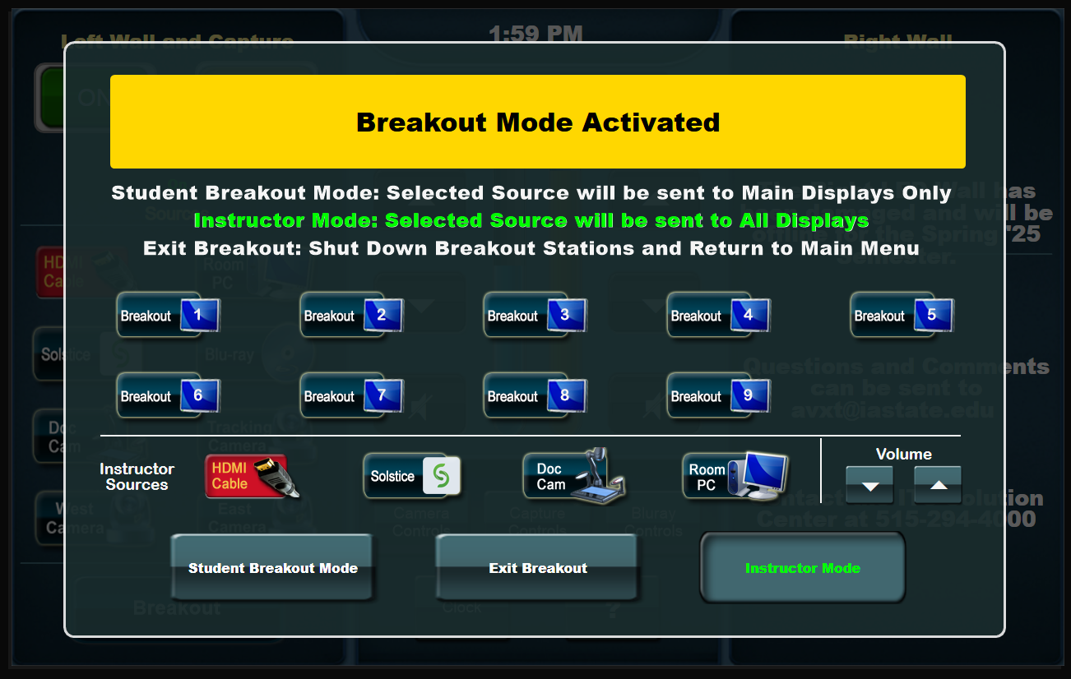
Mapping

Slide 39
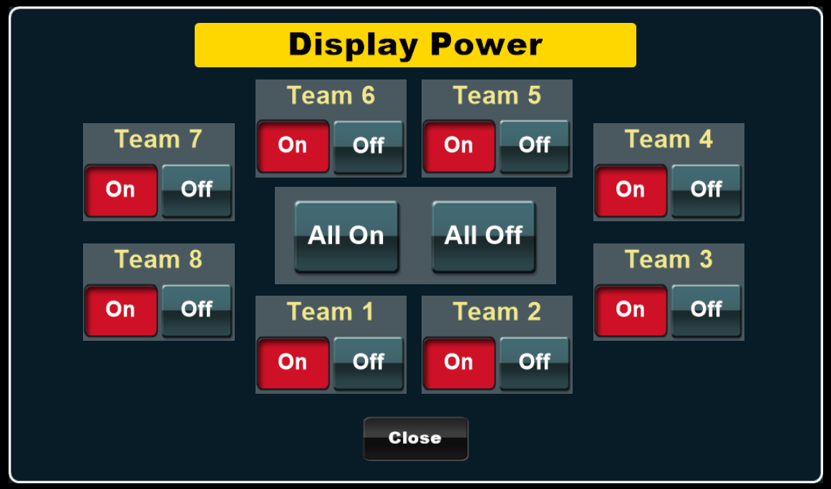
Mapping

Slide 40
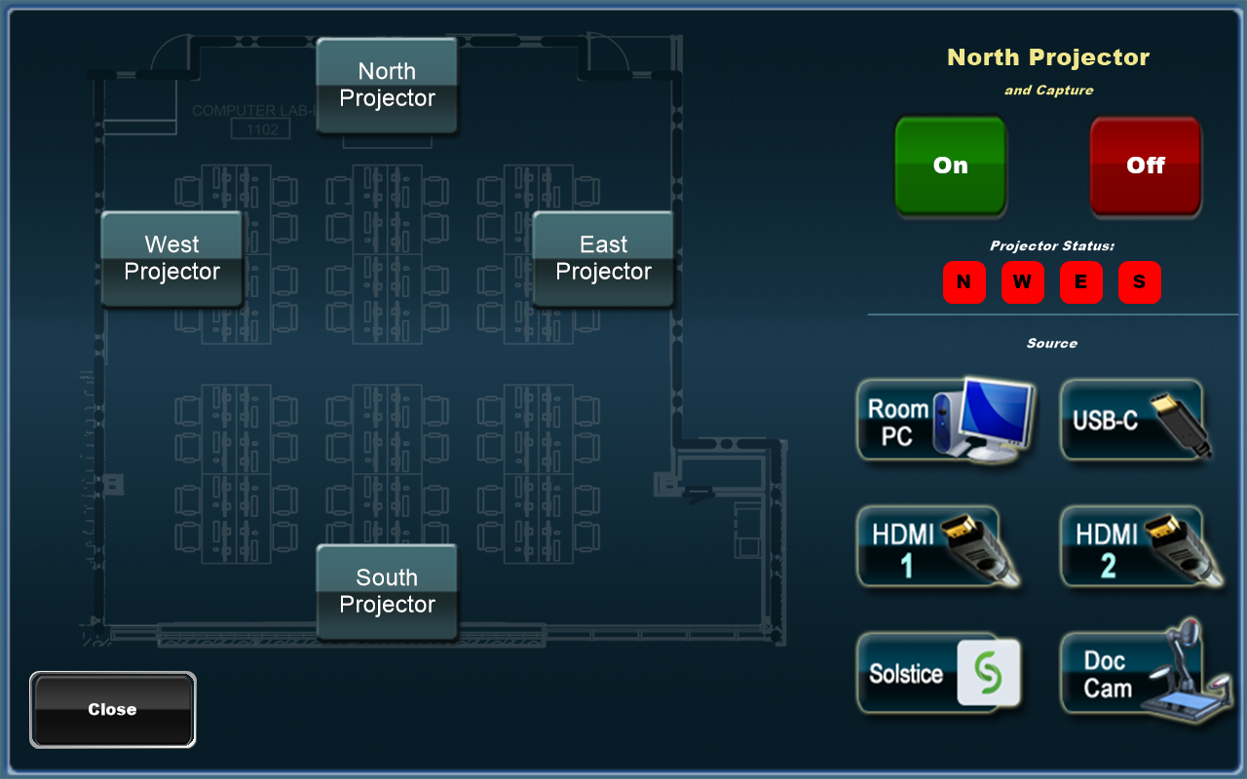
Mapping

Slide 41
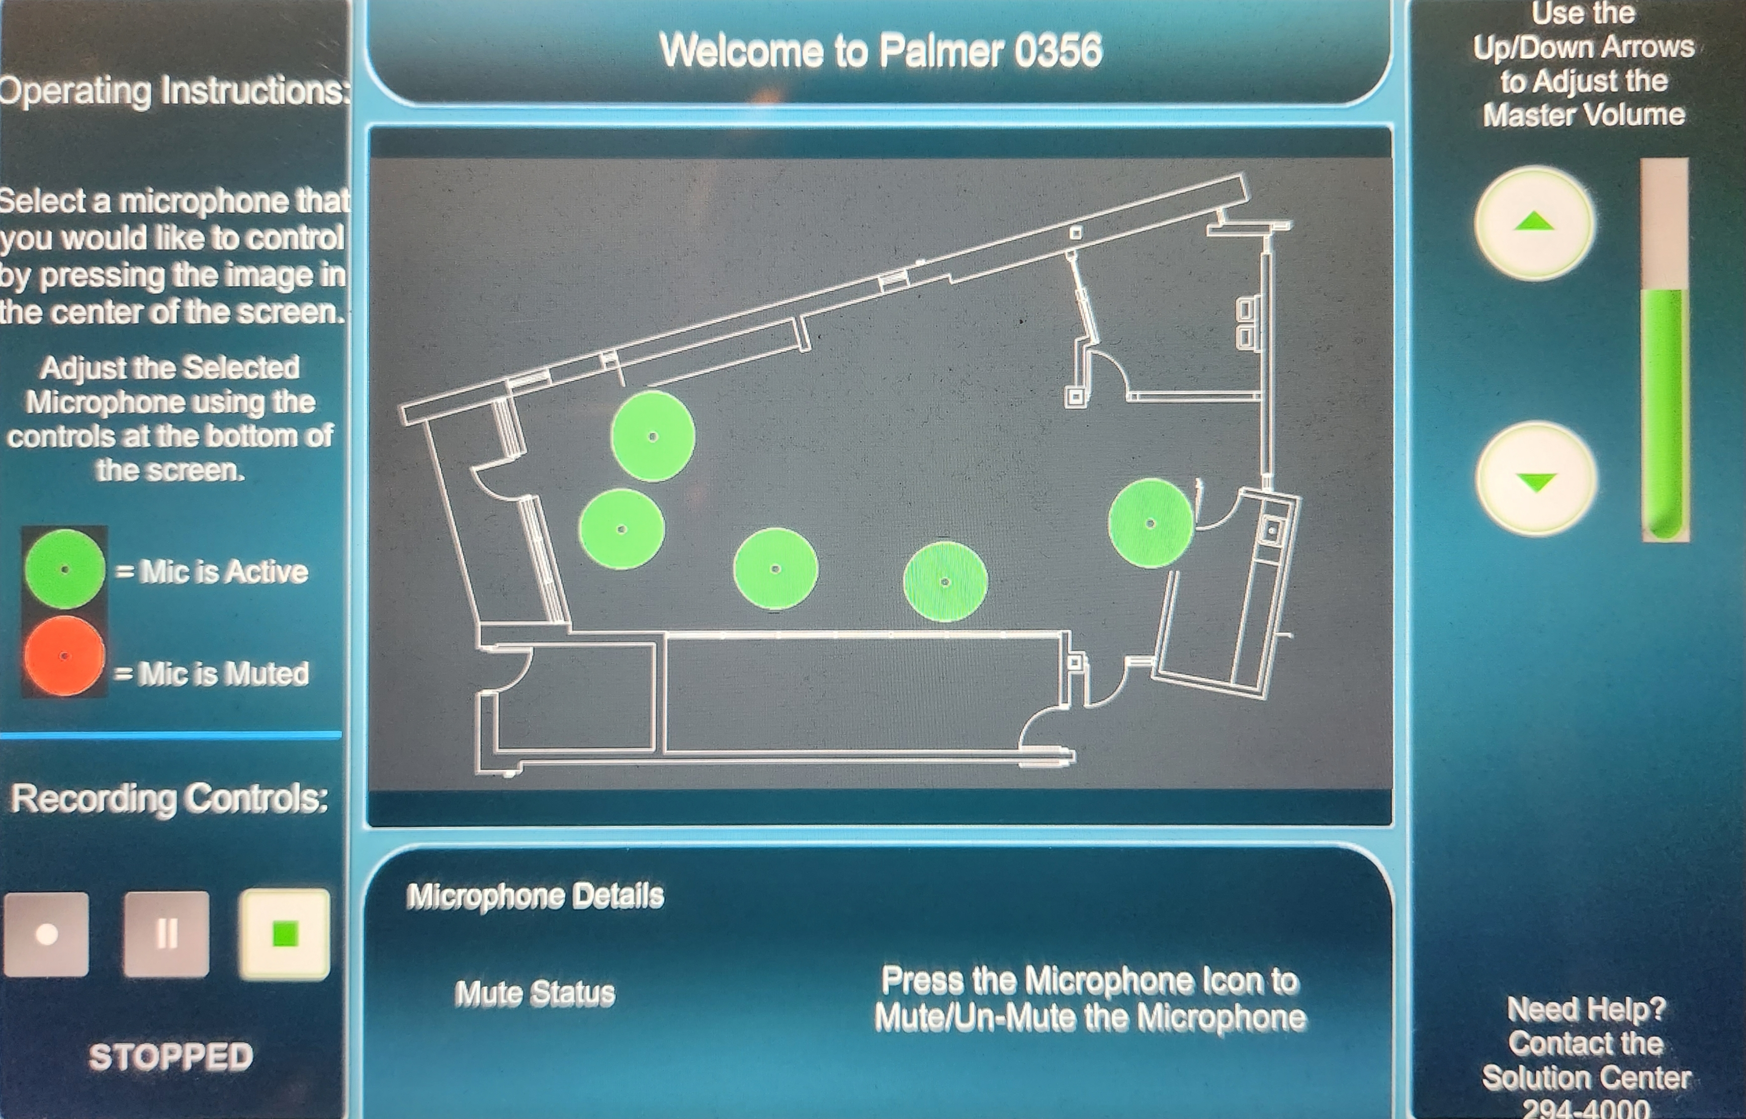
Mapping

Slide 42
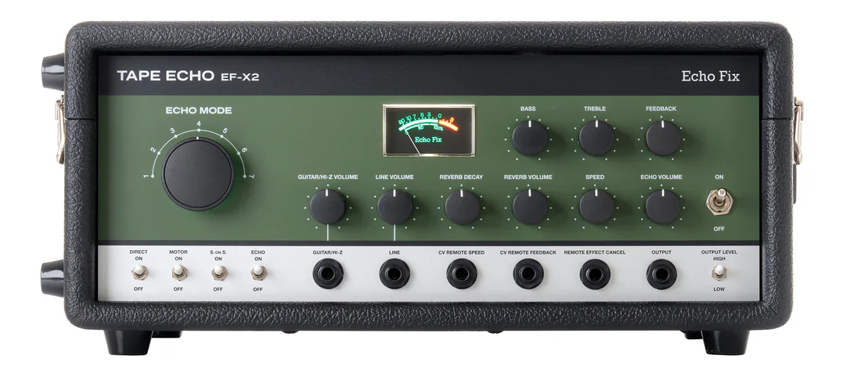
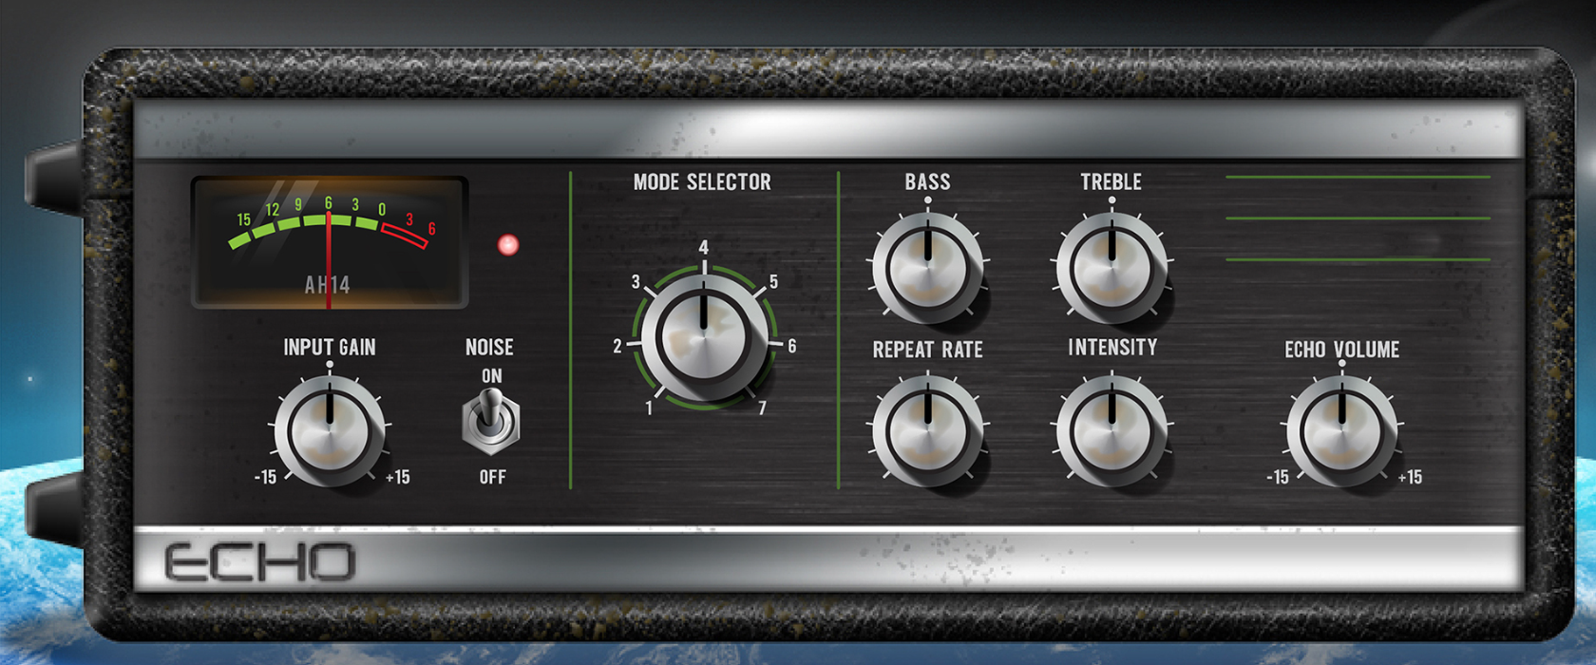
Mapping

Slide 43
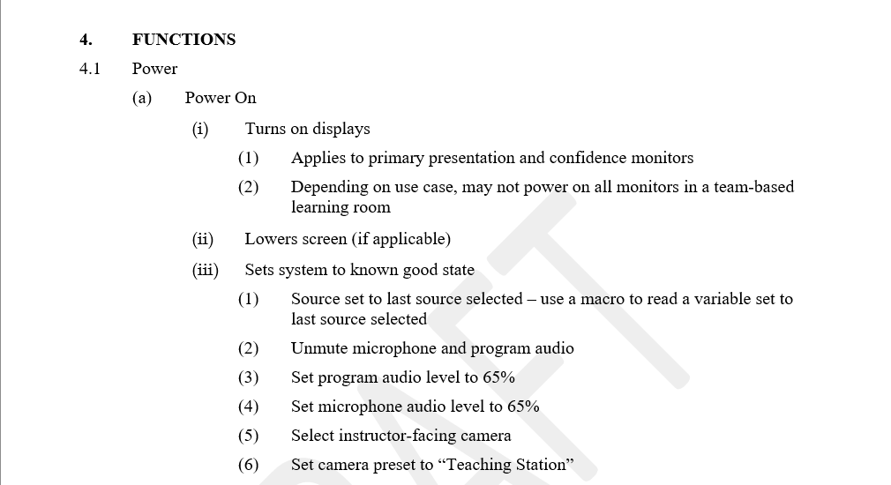
Standardization
Standardization can help
Builds into long-term memory → improvement in top down processing
Stages of “Evaluation” and “Execution” are easier with user familiarity
Increases user confidence

Slide 44
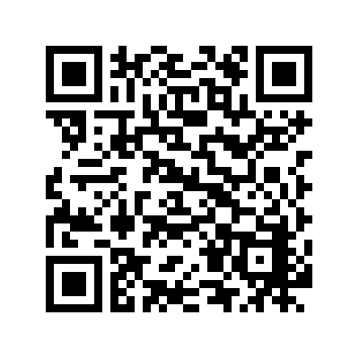


Contact Me
Questions?
Mike Pedersen
mikeped@iastate.edu
@ped1971
@mike-pedersen.bsky.social
Desk: 515-294-9063
LinkedIn

